Slide 1


2026 Judge Training

Slide 2

Always remember…
The Circle of Excellence Awards would not be possible without you. Thank you!
We will help you every step of the way.

Slide 3
Breaking it down
About the Circle of Excellence
What to expect
The three steps to judging:
  1) Confirm you have created a CASE.org account
  2) Review and Score Entries
  3) Winner Selection
Tips, Tricks and Resources

Slide 4
Mark your calendars
March 25: You begin reviewing and scoring entries
April 22: Deadline for completing your judging and scoring
April 22 – May 27: Lead judge convenes your panel to select winners
May 27: Deadline for lead judges to indicate category winners and provide public comments about the winning entries in OpenWater
Late June: CASE announces winners on the CASE website

Slide 5
The 2026 Circle of Excellence Program
Each entry gets considered for recognition twice (saving members money):
  Global recognition (Grand Gold, Gold, Silver or Bronze)
  District or Regional recognition (Best of CASE District V, Best of CASE Europe, etc.)
Five categories are judged based on staff size (Advancement Services Initiatives; Communications Initiatives; Annual/Regular Giving Fundraising Campaigns; Multi-year Fundraising Campaigns; Marketing Initiatives)
  Confirm the email you used to register is connected to your CASE account. This will allow you to sign into the awards portal when nominations are ready to be reviewed and scored.

Slide 6
The 2026 Circle of Excellence Program continued..
We are aiming to have each category have a judge from each US/Canada district and from at least one of the CASE regions (Asia-Pacific, Europe or Latin America).
Each category has five criteria on which entries will be evaluated.
Judges are required to score entries from 1 (low) to 10 (high) on each of the five criteria.
Average scores will be shared with Districts/Regions after the Circle of Excellence winners have been named, to inform their selection for “Best of….” their District/Region.

Slide 7
What to expect
Review category description and judging criteria.
Review and score assigned entries.
Participate in discussion(s) to help select winners.

Slide 8
What to expect: Time commitment
Until we know how many entries we receive, it is hard to predict the time commitment, but we have put several things in place to lighten the lift, including:
Reduced the number of questions in the nomination form
250-word count for responses
Judging criteria shared directly on nomination form so you can more quickly assess and score entries

Slide 9
What to expect: Time commitment
March: 1-2 hours (may be less for return judges familiar with OpenWater)
  Judge training (combination of live and on-demand options).
March 25-April 22: 15-20 hours (est. 10-20 minutes/entry depending on quality, complexity, etc.)
  Judge and score entries for your category.
April 22-May 27: 1-2 hours
  You meet virtually with others on your panel to discuss and select winners.
By May 27: ~ 1 hour
  Lead Judge submits to CASE the winner list with public comments about each winner, and brief overview of the entries in the category overall.

Slide 10
2. Review and Score Entries

Slide 11
About OpenWater
It’s very intuitive.
You can’t break it…but remember to save your work.
Use the comments function to share private notes and comments with other judges on your panel.
Bookmark this link. It’s the door to your assignments:
https://tinyurl.com/casejudging
(https://caseawards.secure-platform.com/a/organizations/main/judgescorecards/selectround)

Slide 12
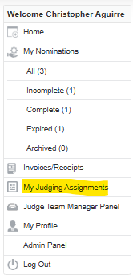
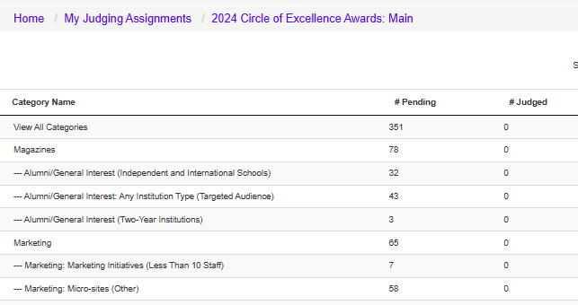
It will look like this
On March 25, you will receive an email from awards@case.org with the link to access entries to judge in OpenWater.
(You will be asked to agree to the CASE Data Privacy Policy in order to proceed.)

Slide 13
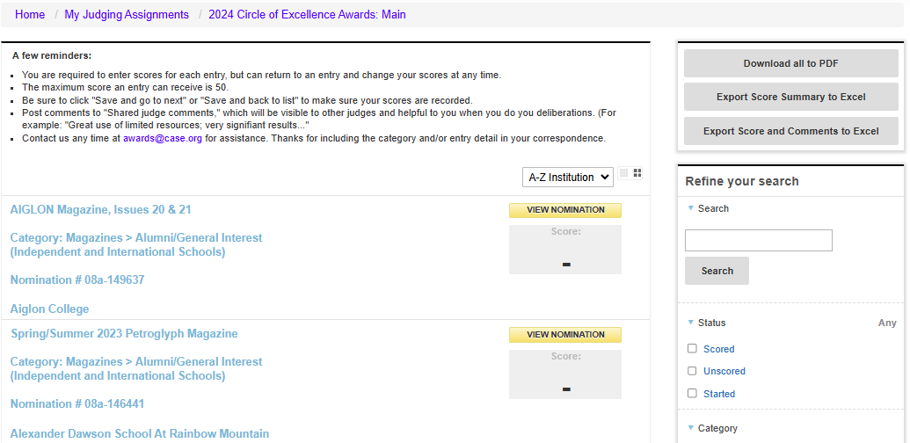
You will only see entries assigned to you
You can:
Sort by institution or score
Filter by status
Download entries

Slide 14
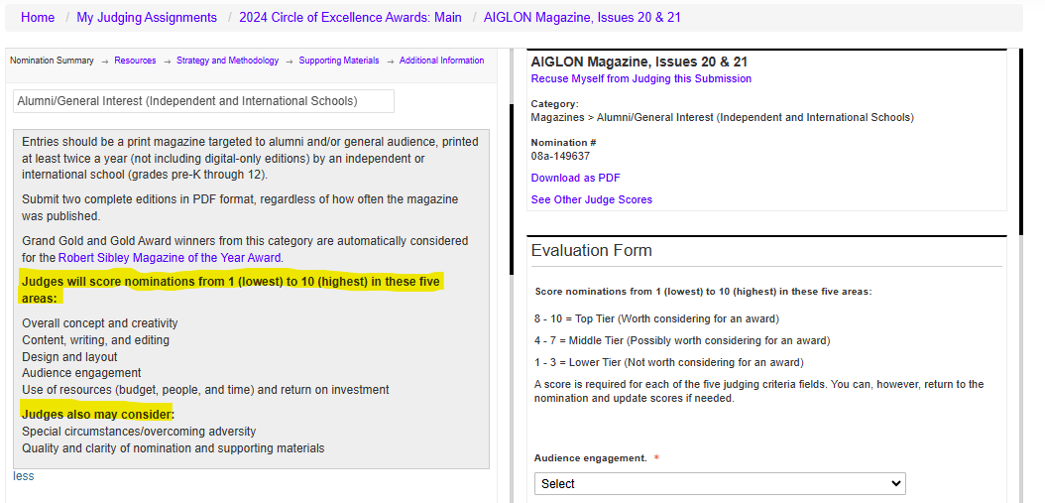
Access the entries
https://tinyurl.com/casejudging
The category description and judging criteria will display on the left panel at the top of each entry.

Slide 15
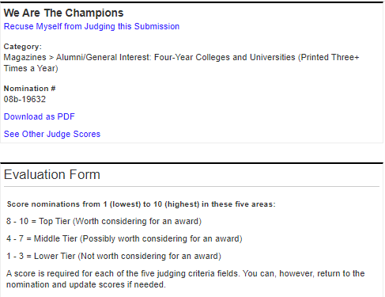
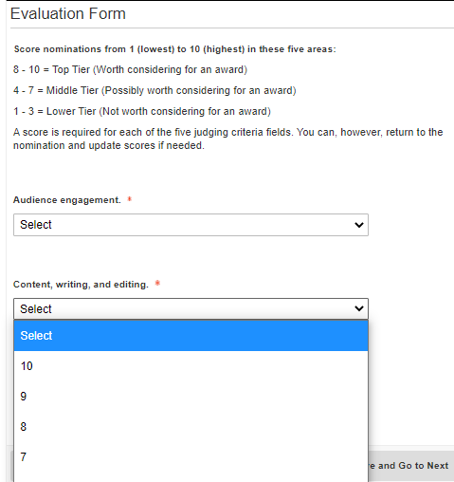
Score each entry
Recuse yourself from judging an entry, if necessary
Score the five scored judging criteria from 10 (high) to 1 (low) with maximum score of 50 points
See scores and comments of other judges
Download responses and attachments, if you like

Slide 16
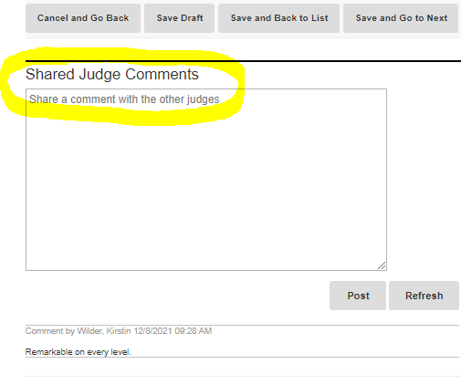
Comment on each entry
Shared Judge Comments:
Will prove helpful during deliberations
Will not be shared outside of your panel
Can be leveraged by the Lead Judge when drafting the public comments about the winning entries

Slide 17
3. Winner Selection

Slide 18
Panel discussions
Lead Judges will schedule a virtual meeting to deliberate and select entries.
Thank you for being flexible, as the judge panels will span at least two countries and four time zones.
Use scores only to identify the competitive entries. We do not select winners based solely on numerical scores.
  Reminders:
  Your entries should be reviewed and scored no later than April 22, so deliberations and winner selection can occur by May 27.
  May 27 is the last day to indicate winners and enter public comments into OpenWater.

Slide 19
Recognition levels
There is no set formula to determine how many awards to give.
We rely on the Lead Judges to make sure that only deserving entries are awarded.
There is no requirement to make awards at every level.
Scores alone should not determine winners or award levels.
Level | Guidelines
Grand Gold* | Reserved for those rare entries that are extremely exceptional or “game-changing.” A Grand Gold Award is the highest level of recognition possible, so your panel should be completely convinced that an entry is deserving of such recognition. Note: There can only be one Grand Gold Award per category.
Gold | Entry that meets or exceeds all of the judging criteria; exceptional in nature.
Silver | Entry that meets or exceeds most of the judging criteria; outstanding in nature.
Bronze | Entry that meets or exceeds many of the judging criteria; distinguished in nature.

Slide 20
Resources & Next Steps

Slide 21
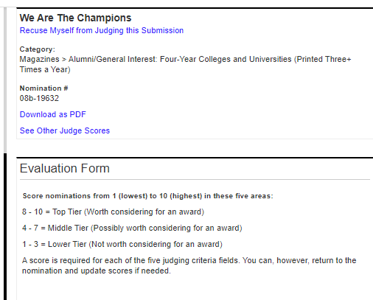
Guidance re: Conflicts of Interest
Please recuse yourself from reviewing, scoring and discussing entries from your institution.
Please recuse yourself from judging a category if you have personally submitted an entry for that category.
Not sure? Email awards@case.org

Slide 22
Don’t let this happen to you
Here are some of the most common issues that judges encounter:
Multiple logins/usernames. Make sure you are using your CASE.org web credentials to sign into OpenWater
Waiting to start. Log in as soon as entries are released to make sure you can access and score entries.
Lost scores/notes. Save often!

Slide 23
Tips, Tricks and Don’t Forgets
Judging FAQs:
https://www.case.org/awards/circle-excellence-awards/volunteer-judges
Adding comments to each entry will be helpful when your panel deliberates.
Your Lead Judge can answer questions about judging and scoring criteria, if you should recuse yourself, or if you think an entry does not meet the category criteria. CASE staff is also available to answer any questions at awards@case.org.
Make notes about industry trends, patterns in entries, the judging process, and other ideas that we can use to continue to make improvements for next year.

Slide 24
Next Steps
Look out for an email on March 25 from awards@case.org to access your assigned entries. (Please remember to double-check your spam folder.)
Weekly Judging Help Office Hour: Thursdays at 3-4pm ET beginning on April 2- https://case-org.zoom.us/j/7921364767

Slide 25
We are eager to help
The quickest way to get answers:
Judges FAQ
Includes responses to frequently asked questions, and training resources
awards@case.org
Thanks for including your district/region category name (and entry name, if relevant) in your correspondence. Technical issues? Include screen grabs and your username.
Drop into our weekly Judging Help Office Hour:
Thursdays at 3-4 p.m. Eastern Time (beginning April 2)
https://case-org.zoom.us/j/7921364767

Slide 26

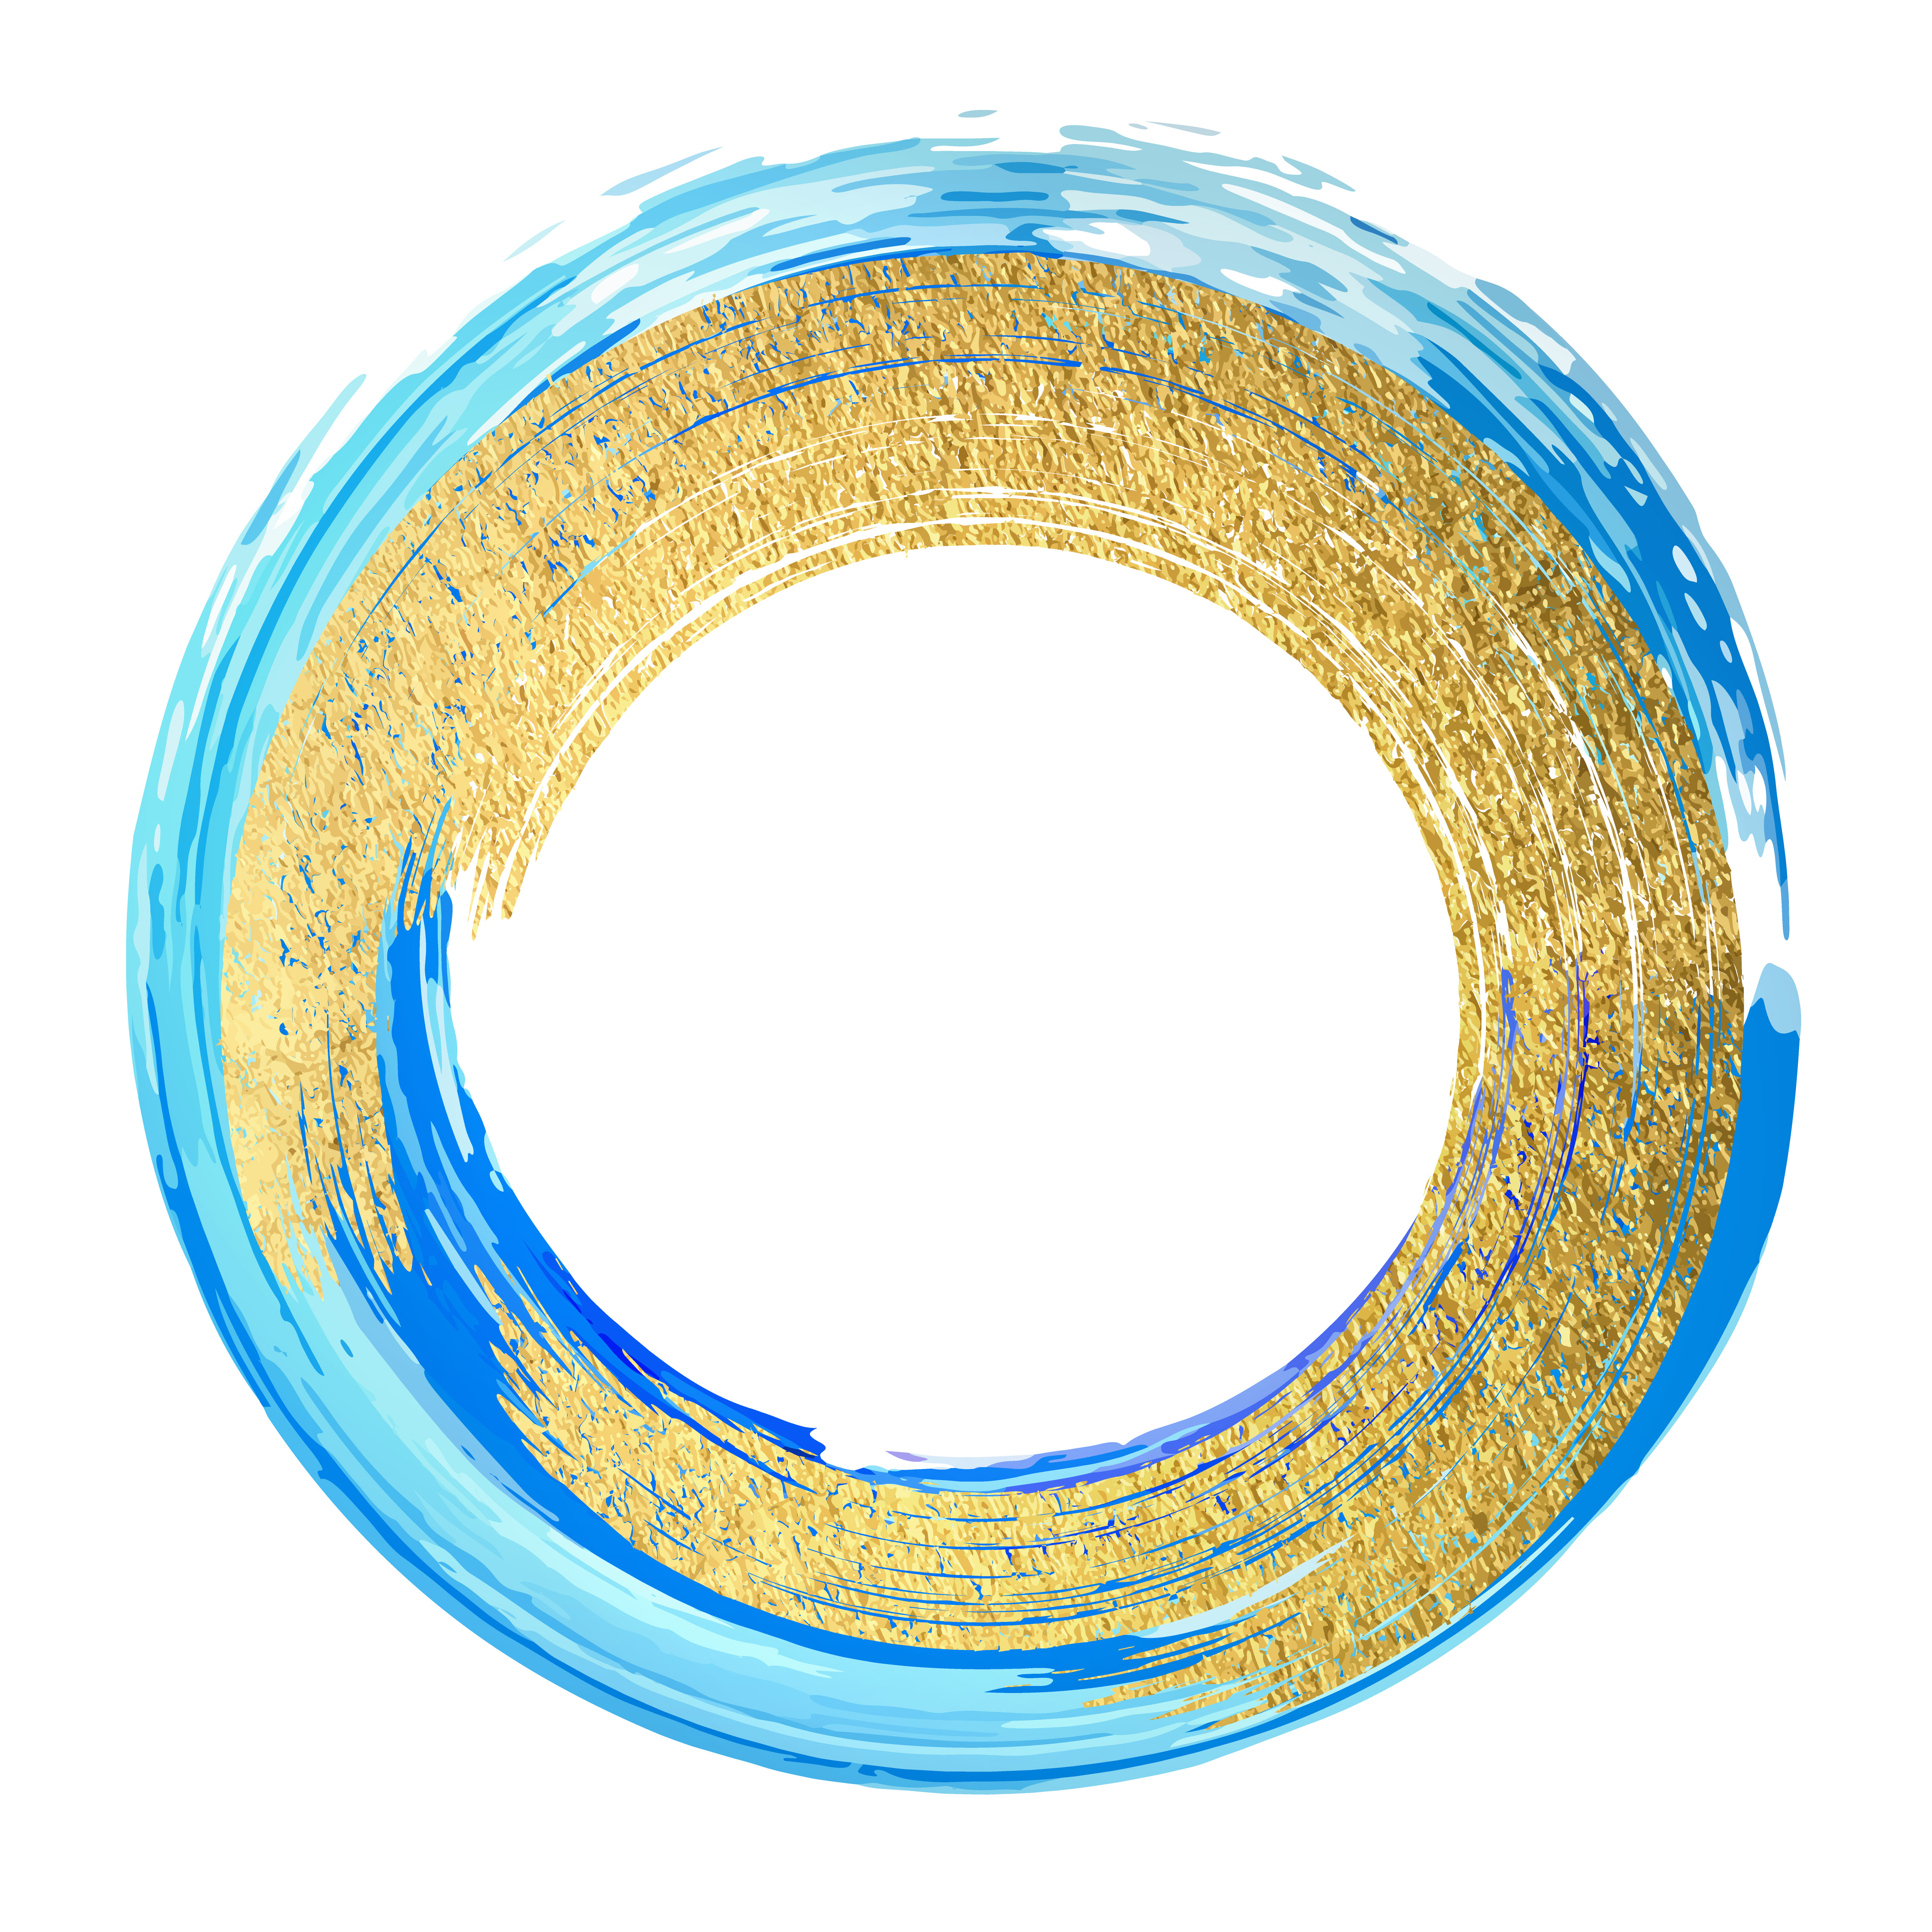
Thank you!

Slide 27



