Slide 1
2024 Lead Judge Training

Slide 2
Always remember…
The Circle of Excellence Awards would not be possible without you. Thank you!
We will help you every step of the way.

Slide 3
Demo
https://caseawards.secure-platform.com/a/

Slide 4
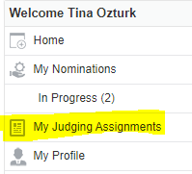
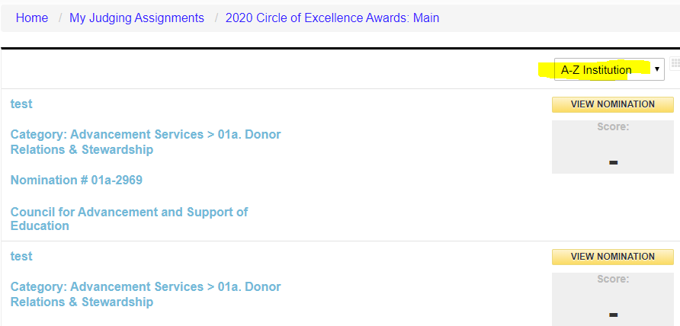
Access the Entries

Slide 5
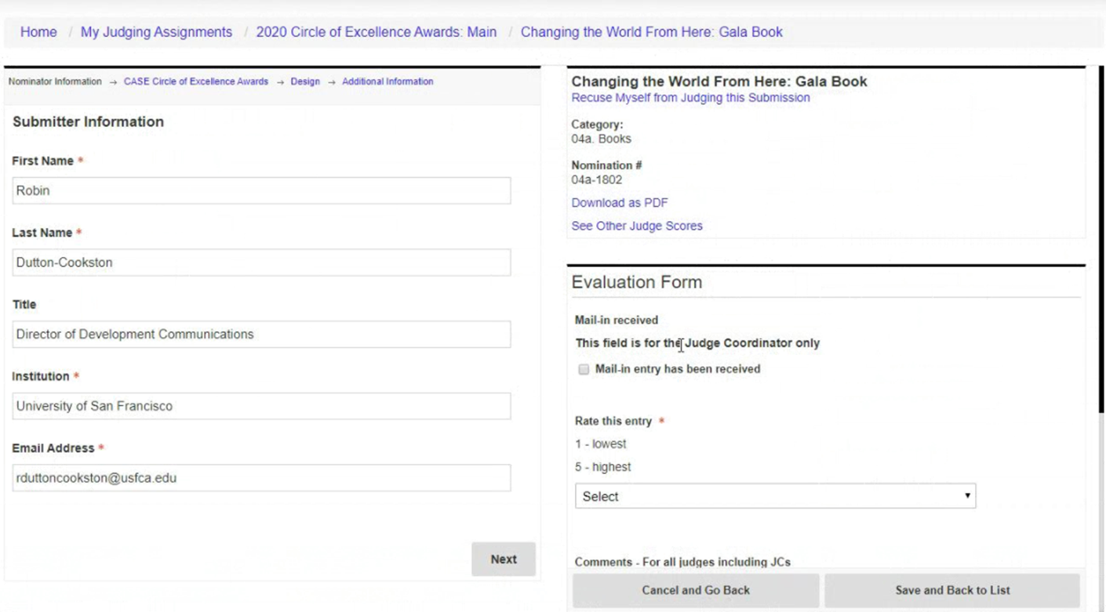
Access the Entries

Slide 6
Score the Entries
Add internal comments to help with scoring and deliberations.
Score 10 (high) to 1 (low).
OW automatically calculates averages which can be sorted and used to determine the top contenders.
Judging Criteria:
Content, writing, and editing
Layout, design, and print quality
Creativity
Effective use of budget and other resources
Serving your audience

Slide 7
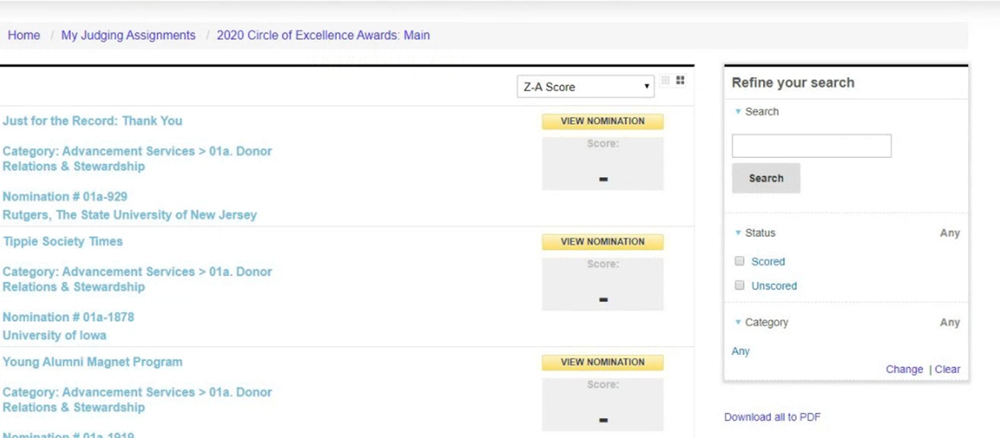
Winner Selection
Sort entries by average score to help focus deliberations

Slide 8
Tips and Tricks
Add comments to capture your opinions of the entries.
Go “Home” if you get lost.
Send technical questions to: awards@case.org.

Slide 9
Breaking it down
Timeline
What to Expect
Judging Assignments
The three steps to lead judging:
Meet and support your panelists
Schedule and convene judges for the winner selection calls
Indicate winners with public comments in OpenWater
Tips, Tricks and Resources

Slide 10
Mark your calendars
March 27: Begin reviewing and scoring entries
Connect with your panel
Secure date/time to convene panel to select winners
April 24: Deadline for completing your judging and scoring
April 24 – May 22 : Lead judge convenes your panel to select winners
Possible second round of judging for categories with 50+ entries
May 22: Deadline for lead judges to indicate category winners and provide public comments about the winning entries in OpenWater
June 26: CASE announces winners on the CASE website

Slide 11
What to Expect: Lead Judges
Lead the judging process for the assigned category.
Keep judges on schedule, answer their questions about recusals, judging/scoring, and judging criteria.
Schedule and convene judges (virtually) to discuss and select winners.
Provide 2-3 sentences explaining why each winning entry was selected.

Slide 12
Judging Assignments

Slide 13
The Circle of Excellence Panel
Neary 100 Circle of Excellence categories
Panels were designed to have a judge recruited from each US/Canada district and from at least one of the other CASE regions (Asia-Pacific, Europe or Latin America)
6-11 judges on each panel spanning at least three time zones
CASE members and non-members, from both inside and outside of the education field

Slide 14
Judging
For those categories that receive 50+ entries, we are designing the judging process to be three rounds:
Round 1: The entries will be divided across the judging panel.
The judges review and score the entries (weed out the weak/ identify the truly competitive)
Round 2: The entries with the top scores from Round 1 move to Round 2 where all the judges review and score them (identify the strongest contenders). Round 2 should begin on or before April 24
Round 3: The lead judge facilitates winner selection call in which the top contenders from Round 2 are considered for awards.

Slide 15
About the Entries
Entry Assignment Methodology
Average 45 entries/category
Ranges from 2 – 209 entries
62 cat with 45 or fewer entries
31 cat have 46 - 100 entries
7 cat have 100+ entries
≤50 entries – all judges will be assigned all entries to score (one round of scoring)
(updated) 51+entries – each judge was automatically assigned 30 entries to be scored in the first round.
**Assumption: 20 min/entry with a 15-hour maximum time commitment for scoring

Slide 16
Meet and Support Your Panelists

Slide 17
Meet Your Panelists (Smartsheet)
Lead Judge View (SmartSheet)
Entry Count (total)
Round 1 and Round 2 entry counts
District and regional Judges
Name, institution, & email addresses
Not editable
Can export to Excel
Access is tied to the email address where you receive messages from CASE awards

Slide 18
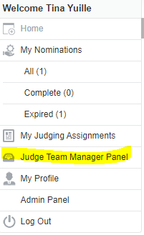
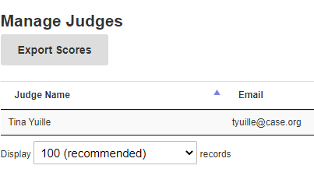
Confirm Your Panel (OpenWater)
You will receive access to your judging panel – ~ on or before March 27
Confirm that your judging panel is correct and complete
Send a note to awards@case.org to request changes

Slide 19
Supporting Your Panel
Help keep your team on schedule
Round 1 scores in by April 24
Round 2 scores (if applicable) in time for winner selections call (May 22)
Judges are required to use the OpenWater scoring mechanism for all assigned entries. Encourage that they all post shared comments when reviewing entries.
Address recusal questions
Judges should not judge categories to which they have submitted entries
Judges should not review, score, or discuss entries from their institutions

Slide 20
Supporting Your Panel – Issues with entries
As soon as possible, please contact awards@case.org if:
An entry was submitted to your category in error
An entry is missing required materials
A document and/or link is not accessible
You are unable to effectively assess the strength of an entry

Slide 21
Things to do
Send a note of introduction early
Sample Letter 1
Sample Letter 2
Sample Letter 3
Work with panel to schedule the winner selection call(s)
Doodle.com (free scheduling tool)
The World Clock
Zoom (40 min free video conferences)
Email awards@case.org if you feel that an entry is incomplete. We err towards inclusion and will work with entrants to fix issues. Provide category, institution and title of entry/entry ID when emailing.

Slide 22
3. Winner Selection

Slide 23
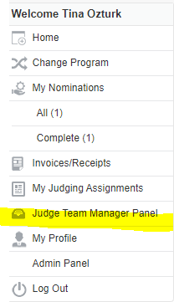
Accessing Judge Team Manager Panel
Only Lead Judges will have access to indicate winners in OpenWater

Slide 24
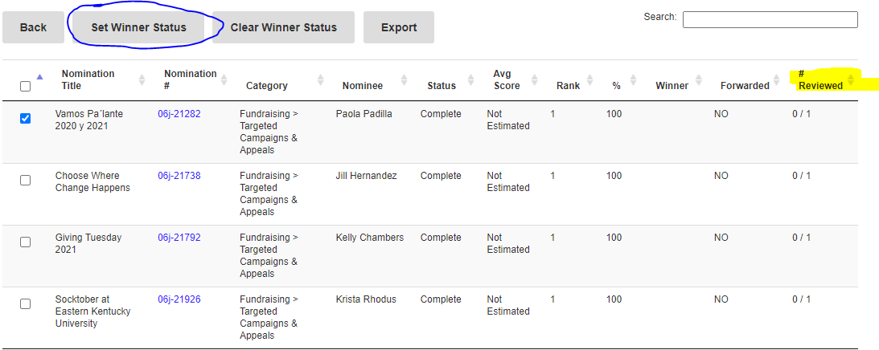
Facilitate Winner Selection
There is no set formula to determine how many awards to give.
We rely on Lead Judges to make sure that only deserving entries are awarded.
There is no requirement to make awards at every level.
Convene your panels to discuss top contenders.
Determine winners and the applicable award levels.
Check the winning entry, then click “Set Winner Status” to award Grand Gold or Gold or Silver or Bronze.

Slide 25
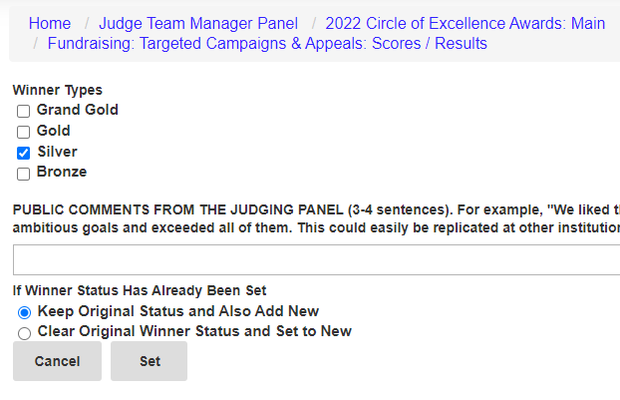
Indicate Winner Type & Add Public Comments
By May 22, please return to the Judge Team Manager Panel to add the 2-3 sentences of public comments explaining why each winning entry was awarded, and 2-3 sentences about the pool of entries.
Consider leveraging the shared judge comments.
In a tight situation, feel free to email awards@case.org with your winners and comments and we will add them on your behalf.

Slide 26
Panel Discussions
The Lead Judges will schedule a virtual meeting to deliberate and select entries.
Thank you for being flexible, as the judge panels will span at least two countries and four time zones.
Use scores only to identify the competitive entries. We do not select winners based solely on numerical scores.
Reminder: May 22 is the last day to indicate winners and enter public comments into OpenWater.

Slide 27
Recognition Levels
There is no set formula to determine how many awards to give.
We rely on the Lead Judges to make sure that only deserving entries are awarded.
There is no requirement to make awards at every level.
Scores alone should not determine winners or award levels.
Level | Guidelines
Grand Gold* | Reserved for those rare entries that are extremely exceptional or “game-changing.” A Grand Gold Award is the highest level of recognition possible, so your panel should be completely convinced that an entry is deserving of such recognition. Note: There can only be one Grand Gold Award per category.
Gold | Entry that meets or exceeds all of the judging criteria; exceptional in nature.
Silver | Entry that meets or exceeds most of the judging criteria; outstanding in nature.
Bronze | Entry that meets or exceeds many of the judging criteria; distinguished in nature.

Slide 28
Public Comment Prompts
Provide three words or expressions to describe this award entry.
What is special or unique about this award entry?
Why did this submission catch your eye?
Does this submission address an issue that you often see in advancement/education? If so, how?
Could you use this (practice, idea, program) at your institution? How?

Slide 29
Resources & Next Steps

Slide 30
Guidance re: Conflicts of Interest
Please recuse yourself from reviewing, scoring and discussing entries from your institution.
Please recuse yourself from judging a category if you have personally submitted an entry for that category.
Not sure? Email awards@case.org
You will receive an automated email from awards@case.org if one of your judges recuses themselves.

Slide 31
Tips, Tricks and Don’t Forgets
Judging FAQs: https://www.case.org/awards/circle-excellence-awards/volunteer-judges
Adding comments to each entry will be helpful when your panel deliberates.
As Lead Judge, please support your panels by answering questions about judging and scoring criteria, recusals, or if you think an entry does not meet the category criteria.
Consider tools like zoom (free 40min); https://www.timeanddate.com/worldclock/; and doodle.com to schedule and host the deliberation call.
Make notes about industry trends, patterns in entries, the judging process, and other ideas that we can use to continue to make improvements for next year.

Slide 32
Next Steps
Look out for an email on or @March 27 from awards@case.org to access your assigned entries. (Please remember to double-check your spam folder.)
Weekly Judging Help Office Hour: Thursdays at 3-4pm ET beginning on April 4- https://case-org.zoom.us/j/7921364767
Any questions, email awards@case.org and include your issue in the subject line and we will provide guidance.

Slide 33
We are eager to help
The quickest way to get answers:
Judges FAQ
Includes responses to frequently asked questions, and training resources
awards@case.org
Thanks for including your district/region category name (and entry name, if relevant) in your correspondence. Technical issues? Include screen grabs and your username.
Drop into our weekly Judging Help Office Hour:
Thursdays at 3-4 p.m. Eastern Time (beginning April 4) https://case-org.zoom.us/j/7921364767

Slide 34
One Last Ask – We Need You
… to help recruit judges
We are looking to fill a few more judging seats. Please send colleagues, associates, and business partners/vendors to awards@case.org if they are interested in volunteering.

Slide 35
Review and Score Entries

Slide 36
Guidance re: Conflicts of Interest
Please recuse yourself from reviewing, scoring and discussing entries from your institution.
Please recuse yourself from judging a category if you have personally submitted an entry for that category.
Not sure? Email awards@case.org

Slide 37
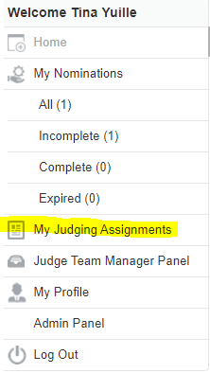
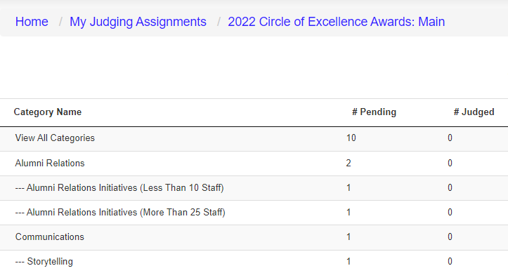
It will look like this
On or before March 27, you will receive an email from awards@case.org with the link to access entries to judge in OpenWater. (You will be asked to agree to the CASE Data Privacy Policy in order to proceed.)

Slide 38
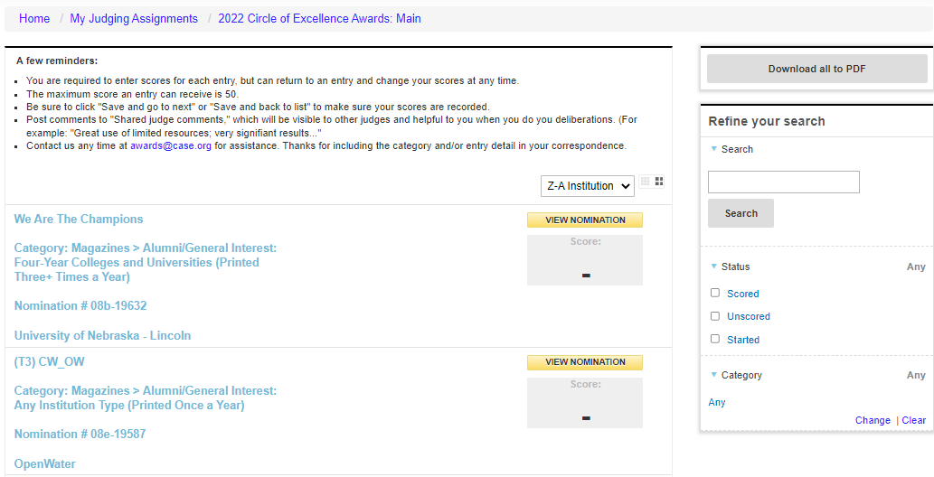
You will only see entries assigned to you
You can:
Sort by institution or score
Filter by status
Download entries

Slide 39
Access the entries
https://tinyurl.com/casejudging
The category description and judging criteria will display at the top of each entry.

Slide 40
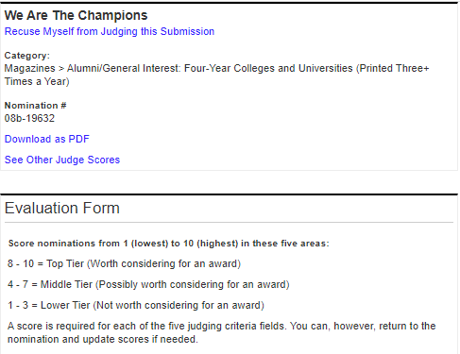
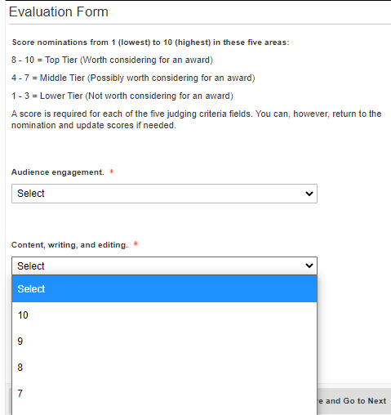
New requirement: Score each entry
Recuse yourself from judging an entry, if necessary
Score the five scored judging criteria from 10 (high) to 1 (low) with maximum score of 50 points
See scores and comments of other judges
Download responses and attachments, if you like

Slide 41
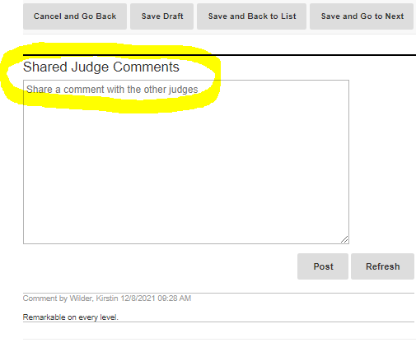
Highly recommended: Comment on each entry
Shared Judge Comments:
Will prove helpful during deliberations
Will not be shared outside of your panel
Can be leveraged by the Lead Judge when drafting the public comments about the winning entries

Slide 42
Thank you!

