Slide 1
Digital Marketing and Gift Giving
Dr. Deva Rangarajan

Slide 2
agenda
Trends in gift giving
Digital marketing tips
Performance
Conclusion

Slide 3
Trends in gift giving: Age differences

Slide 4
Trends in Gift Giving: Direct Mail

Slide 5
Trends in Gift Giving: Social Media

Slide 6
Trends in Gift Giving: Mobile

Slide 7
Priority Areas for gift giving
Health
Religion
Social Services

Slide 8
Giving trends by subsector

Slide 9
Some Digital Marketing Tips
Use optimized video campaigns
Pay per click
Retargeting
Email marketing
Backlinks and influencers

Slide 10
Use optimized video campaigns
Using videos in your emails can double or triple your click-through rates (Hubspot)
Boosts landing page conversion by 80% (Hubspot)
Using the word “video” in a subject line improves email rates by 19% (Hubspot)

Slide 11
PPC Marketing
PPC advertising increases traffic to your website
Using Google Grants can help non-profits to have access to upto 10,000 USD a month in PPC advertising through its Ads service
Analyze data from PPC results to optimize message across channels

Slide 12
retargeting
2% of shoppers convert the first time, retargeting will help engage with the other 98% (AdRoll)
Use Facebook Exchange in combination with AdRoll.
Be careful to remove an individual if they make a donation to avoid spamming
Might be more relevant for bigger non-profits

Slide 13
Email Marketing
Cheap(er)
Use MailChimp (15% discount)
Use alternate source like Aweber Communications to get a 25% discount
Easier to segment donors and send targeted messages

Slide 14
Backlinks and influencers
Your non-profit should have a website (mobile friendly)
Use of like Facebook, LinkedIn, Twitter will help
When other sites link to your pages, you’re improving your website’s reliability as a source of go-to information.
When you backlink you get more credit from Google resulting in a higer listing on their Search Engine Results Page
Use influencers to increase visibility

Slide 15
Performance: Importance of analytics
Stronger relationships
Improved lead generation
Higher contributions
Increased engagement
Decreased marketing spend on printing/mailing costs
Decreasing cost of “sales”

Slide 16
Some metrics to keep in mind
Website Page views
Email open and click-through rates
Landing page conversion ratio
Amplification, applause, and conversation rates
Donation conversions by channel
Fundraising ROI
Donor retention rate
Donor and donation growth
Gifts secured

Slide 17
BECOMING KPI-SMART
Track in regular intervals
Share reports in digestible and visually-attractive formats
Test and learn approach: share what has worked, and what has not

Slide 18
In conclusion
Know your donors
Woo them- do not stalk them
Continue the relationship after the donation
Multichannel marketing efforts will yield better results
Measure impact of your campaigns

Slide 19
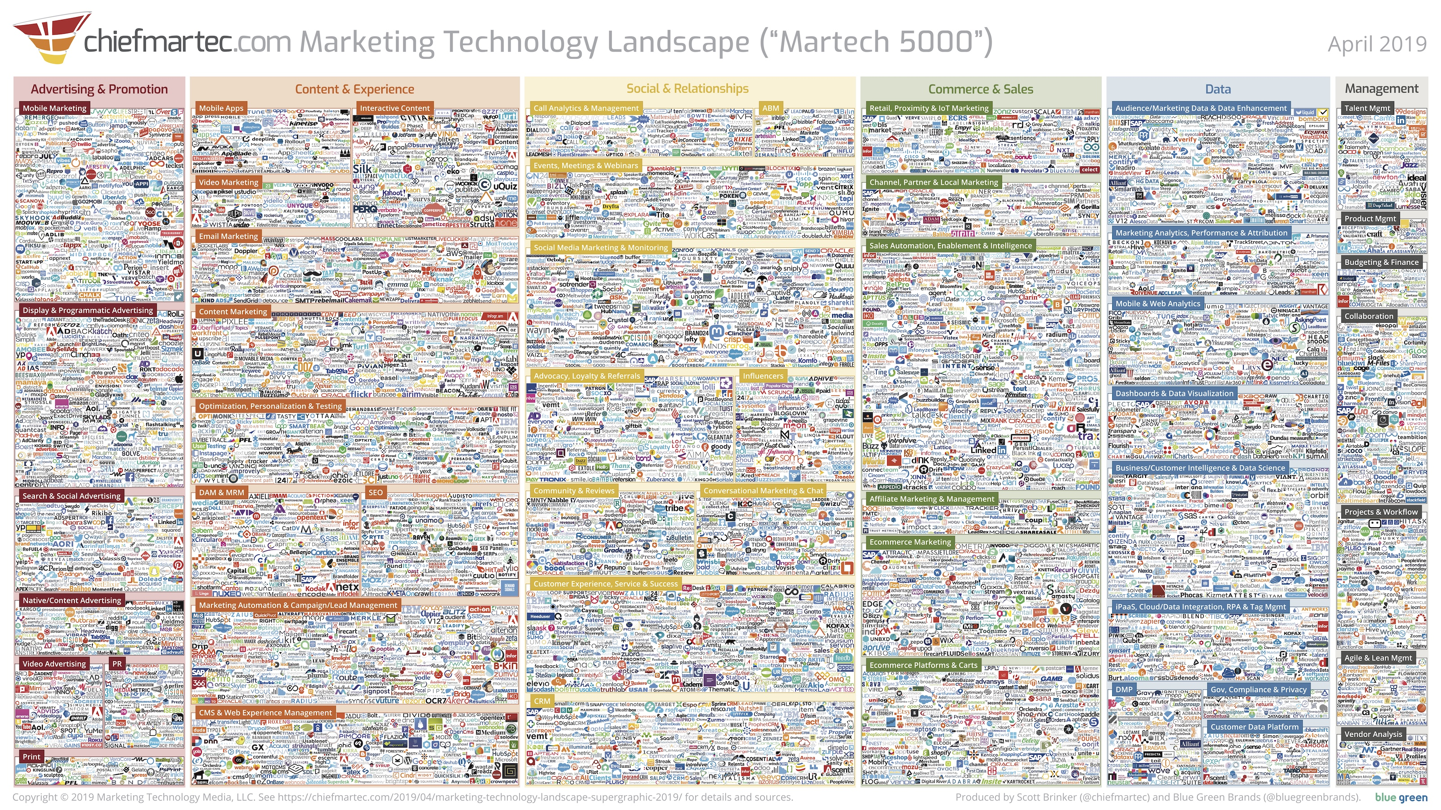
2019 Marketing Technology landscape
Notes:
Organizations that want to be more data-driven have a wide array of marketing technology at their fingertip to track progress.
More than 7000 suppliers in 2019!
For talking points, read: https://chiefmartec.com/2019/04/marketing-technology-landscape-supergraphic-2019/

Slide 20
Thank you
drangarajan@bsu.edu
http://bit.ly/bsusalescenter

