Slide 1
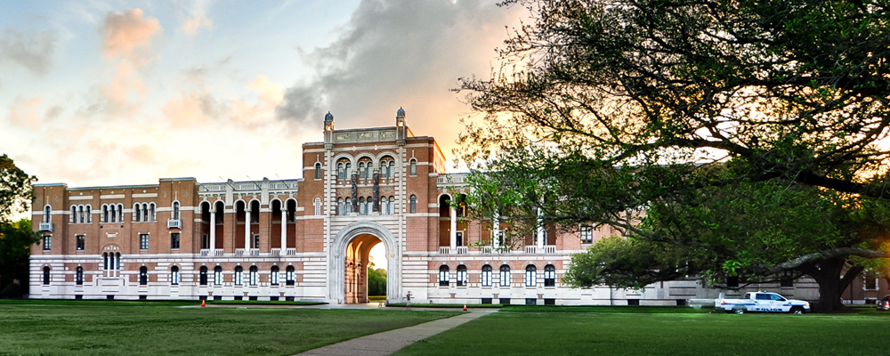
2017 CASE Circle of Excellence
Rice University

Slide 2
TABLE OF CONTENTS
Planning Slide 3
Web Slide 8
Outreach Slide 12
Email Slide 26
Social Media Slide 44

Slide 3
Planning

Slide 4
Early concept

Slide 5
COMMunications

Slide 6
USER SURVEY INITIAL INSIGHTS FROM 08/24/16 SURVEY
4.17/5 for usefulness
“This is very useful for current students as well as alums to be able to reach Rice affiliated individuals. It is useful for parents (like me) to have similar access because many of us are looking to assistance to re-enter our next phase of life. It is like a social network for Rice Affiliated individuals.”
“I think the resources being provided to students in a central location are great! Everything was easy to find and I am very interested to see how the sallyportal will be utilized in the future.”
“Most of my hesitation about the usefulness of the website comes from my concerns below about the clarity and ease of use. If alumni are not immediately attracted to the site, it will be less useful than it would be otherwise.”
4.3/5 for being user friendly
“It is extremely easy to initiate. The most time consuming would be data input.”
“The interface is a [tad] overwhelming and busy. I'm sure that people will get used to if they use it for a while, but I'm concerned that they'll be unsure what to do first and decide not to use it at all. Removing some of the options and clutter might help, to focus on the key elements of the site (i.e., connecting people and providing career opportunities/advice). For example, I don't see much value in the photo album feature, even though it's prominently featured on top of the front page…”

Slide 7
SURVEY CONTINUED
9.67/10 on willingness to recommend
“I cannot wait to share this with all Rice parents.”
“I like the idea of Sallyportal and need to figure out how my group can be helpful.”
“The Sallyportal should be a critical tool for alumni and students, and it seems to me that all the necessary elements of that tool are here. We just need to optimize the interface and get as many people as possible to use it.”
Top reasons for coming back to Sallyportal:
Mentor Rice students and young alumni
Help build a stronger Rice network
Get to know other Rice alumni and parents in my area
Get access to events or volunteer opportunities related to professional development
Look for job opportunities posted to the message board

Slide 8
Web

Slide 9
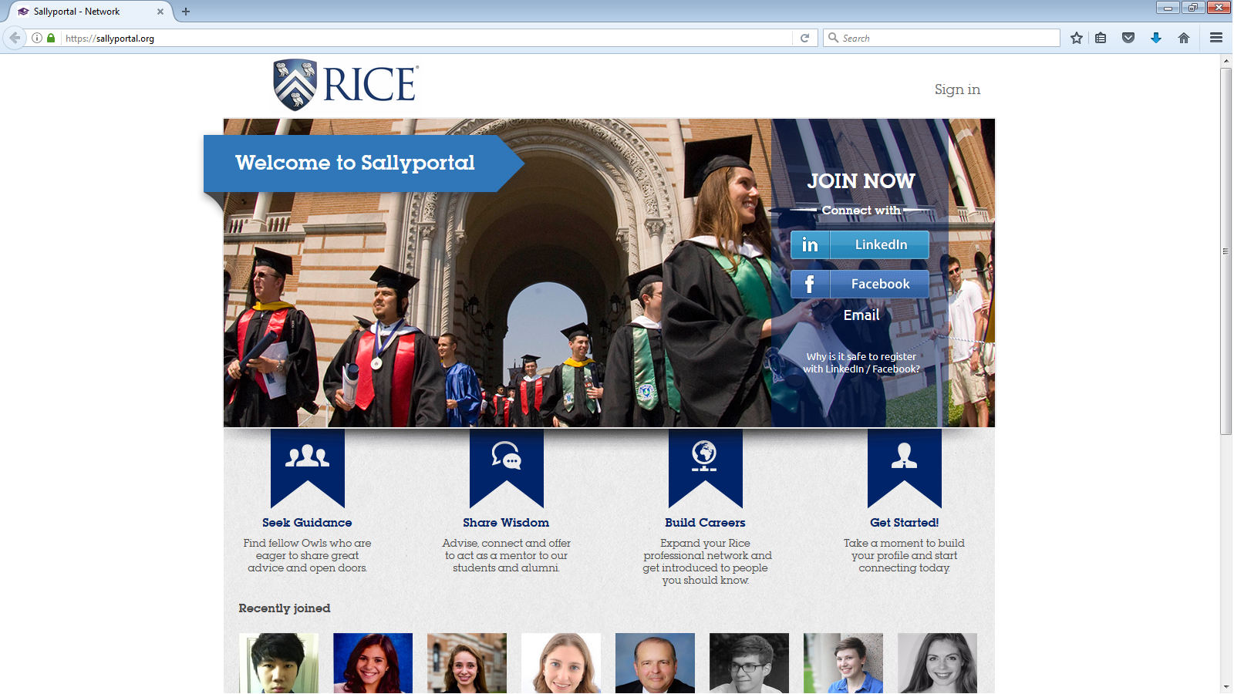
Homepage

Slide 10
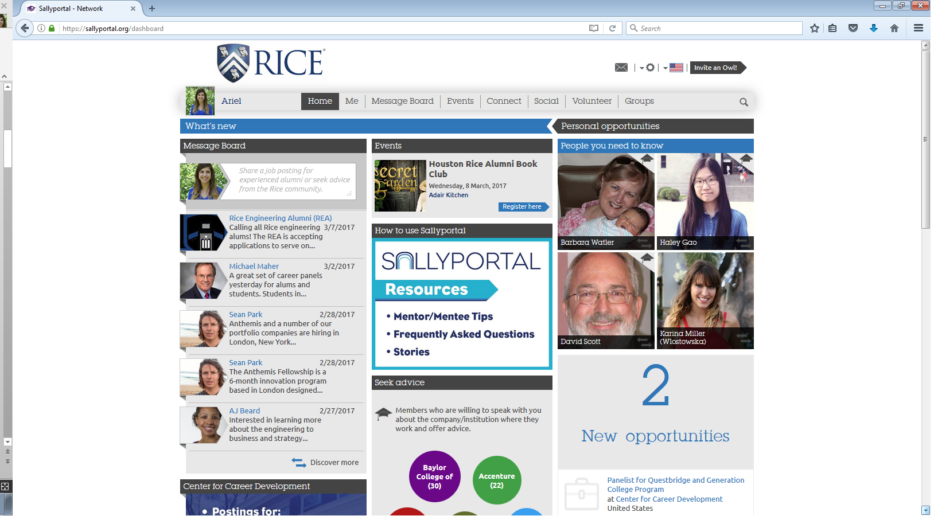
Dashboard

Slide 11
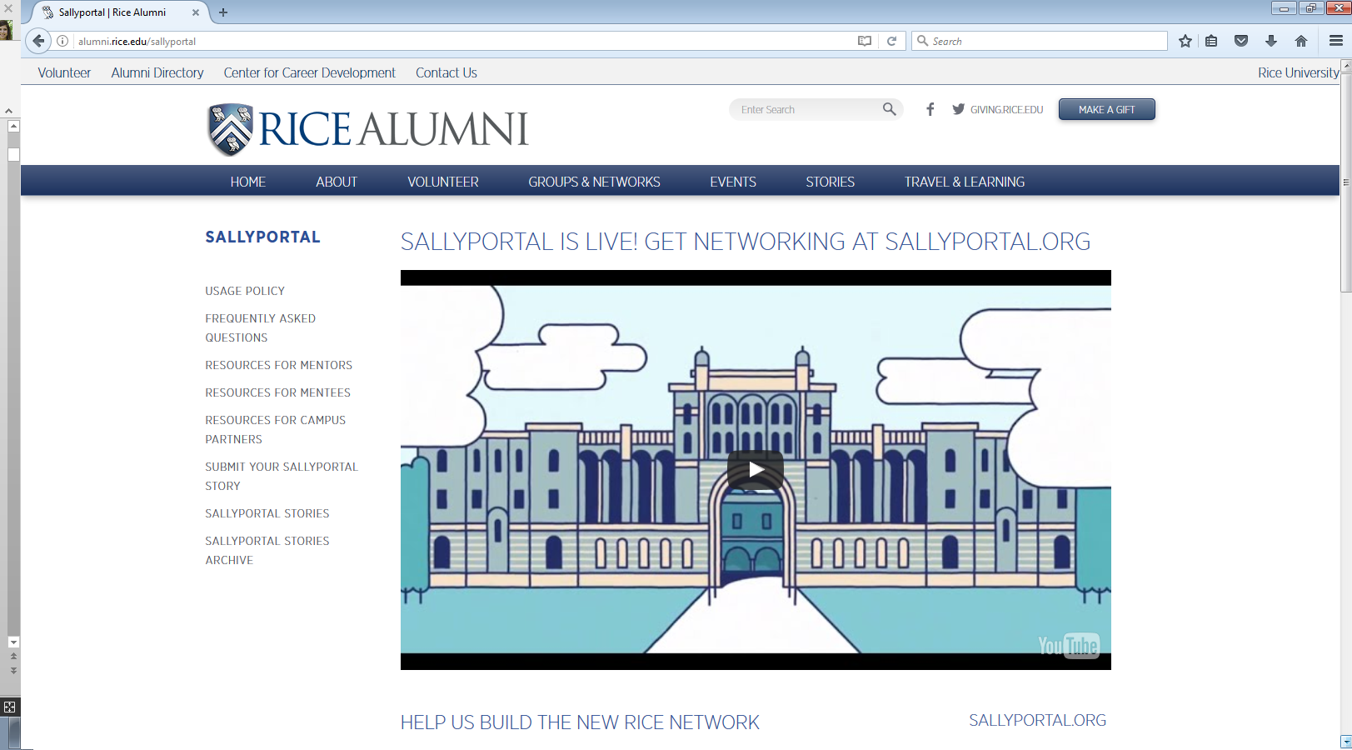
Video

Slide 12
outreach

Slide 13
POSTCARD

Slide 14
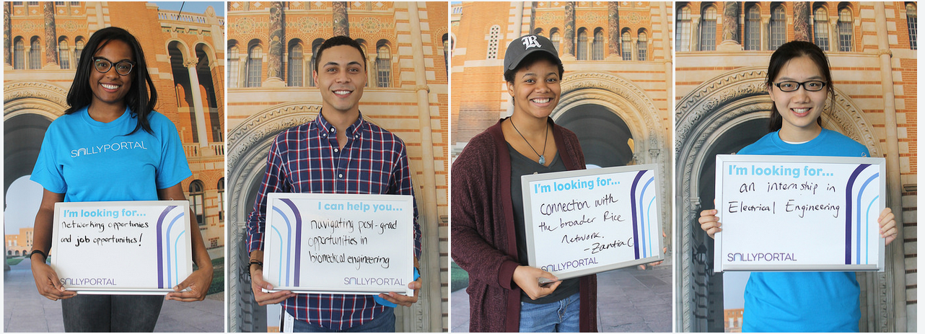
Faces of sallyportal
THE FACES OF SALLYPORTAL https://www.flickr.com/photos/ricealumni/sets/72157673454095932

Slide 16
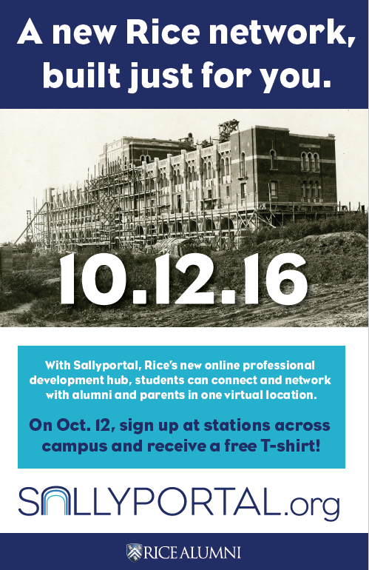
POSTER

Slide 17
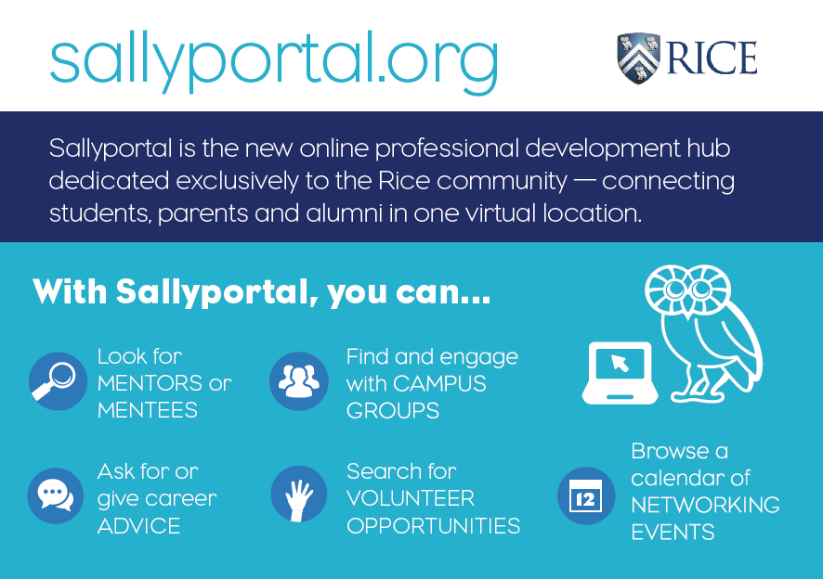
TAKE AWAY CARD (PRINT)

Slide 24
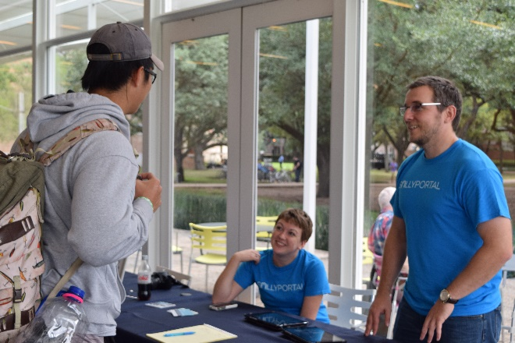
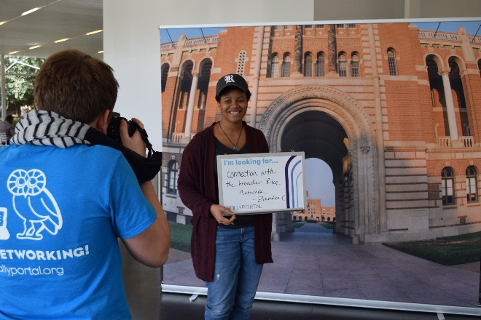
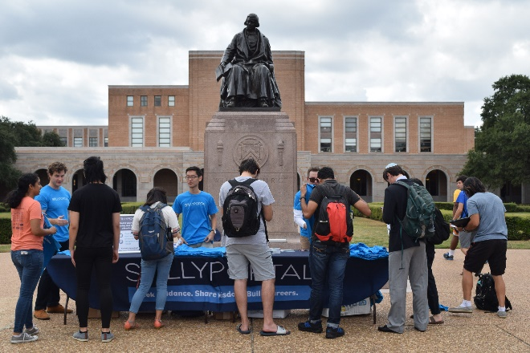
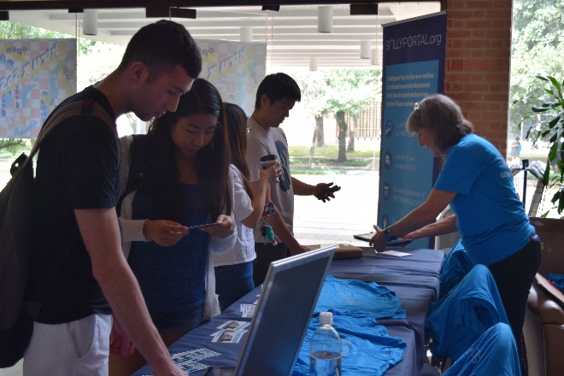
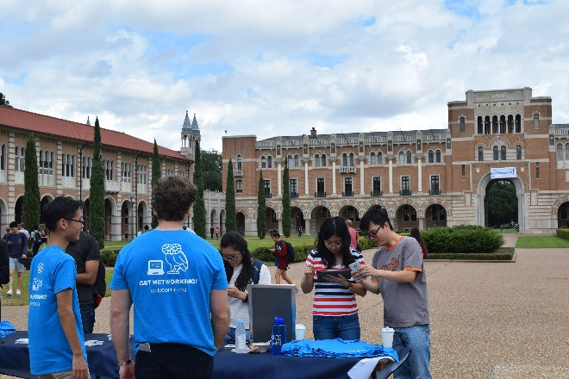
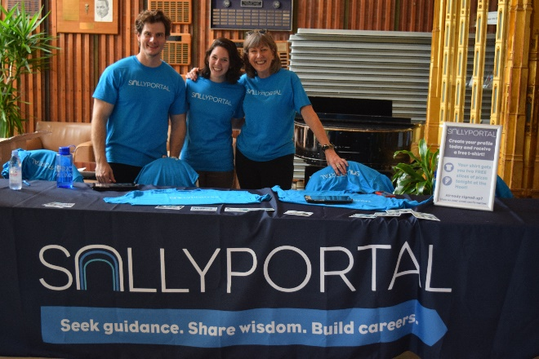
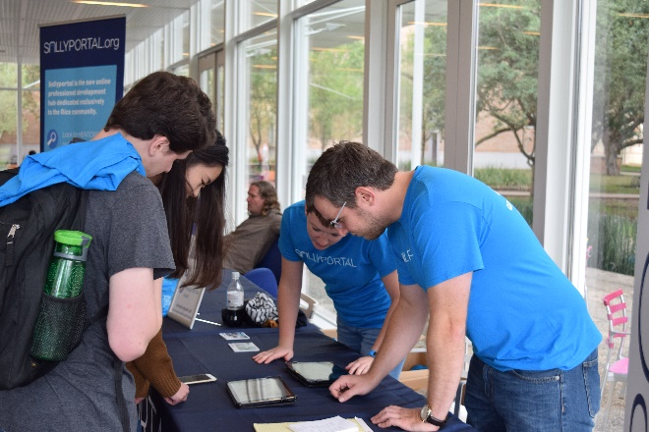
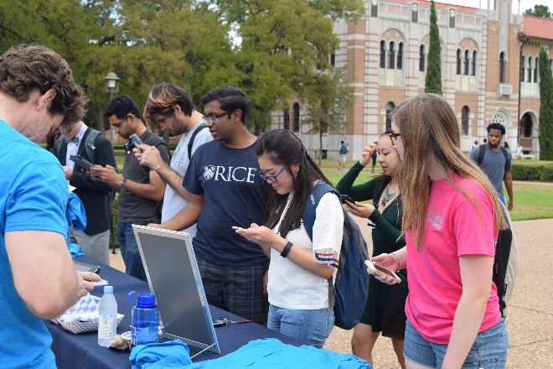
Launch Day

Slide 25
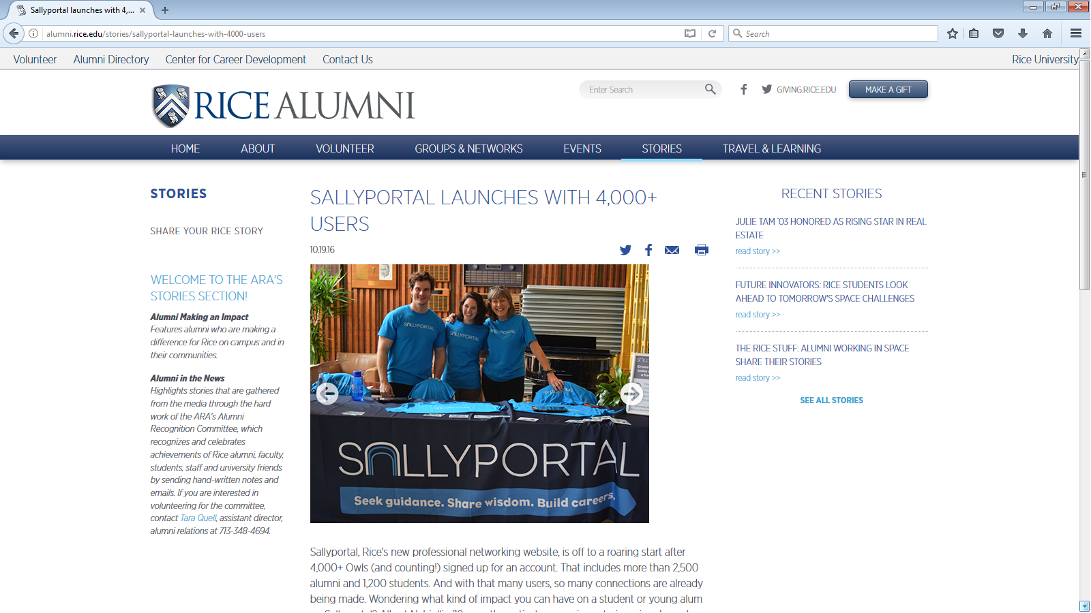

Slide 26
Email & Video
Sallyportal

Slide 27
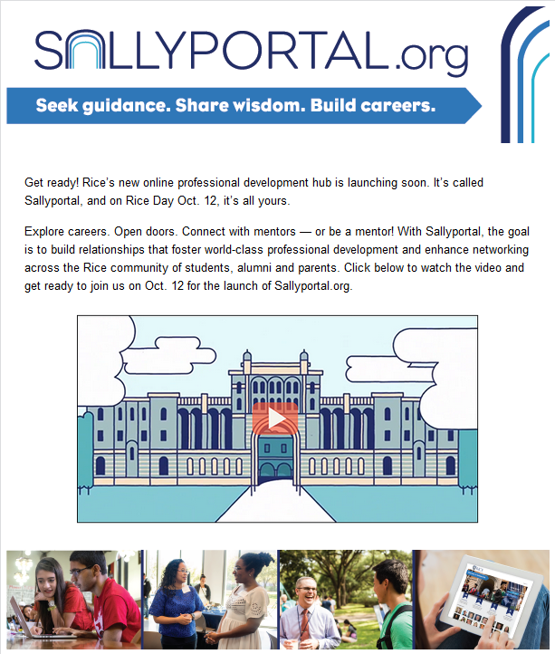
Sallyportal Teaser Email
1 of 3

Slide 28
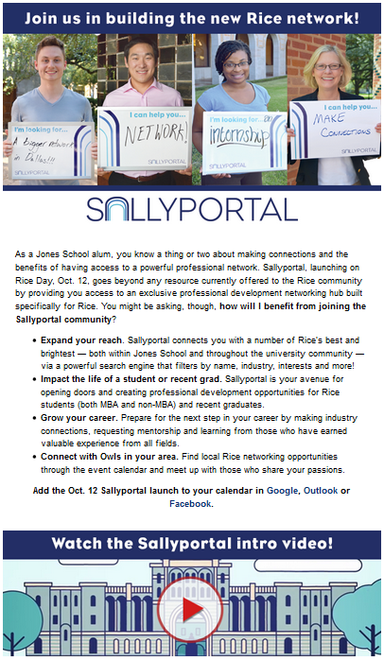
Sallyportal Teaser Email
2 of 3
Jones Grad Alumni

Slide 29
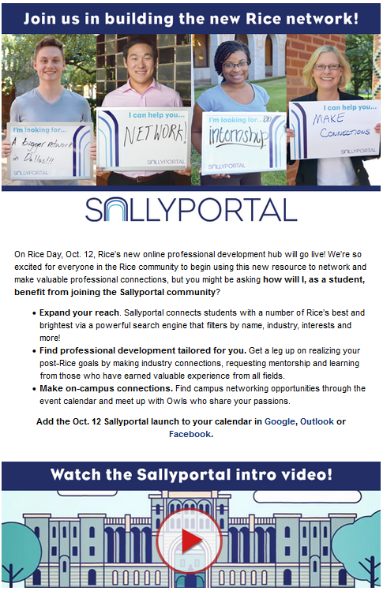
Sallyportal Teaser Email
2 of 3
Undergrad Students

Slide 30
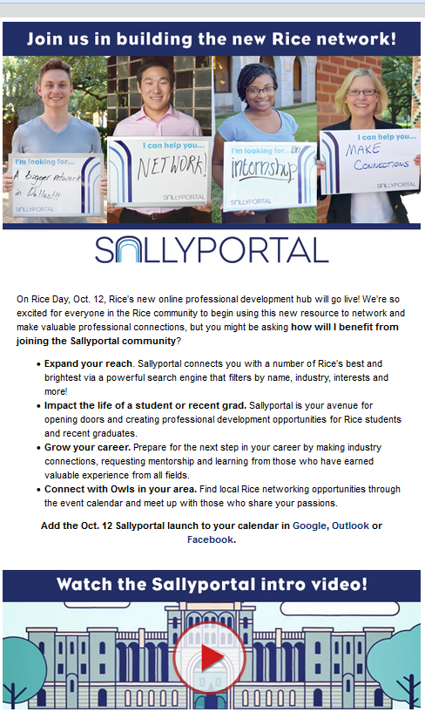
Sallyportal Teaser Email
2 of 3
Undergrad Alumni

Slide 31
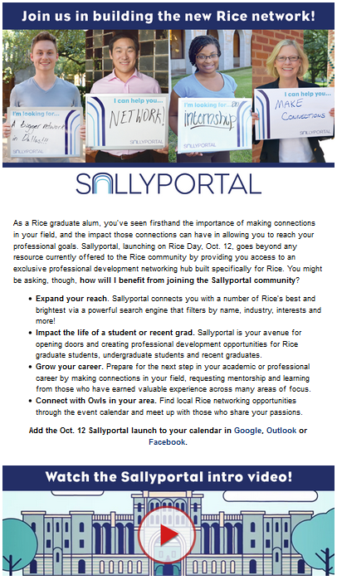
Sallyportal Teaser Email
2 of 3
Grad Alumni

Slide 32
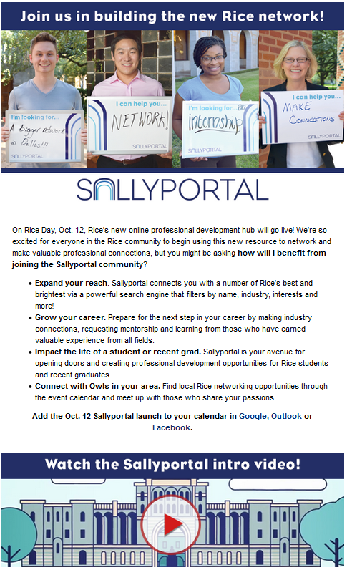
Sallyportal Teaser Email
2 of 3
Young Alumni

Slide 33
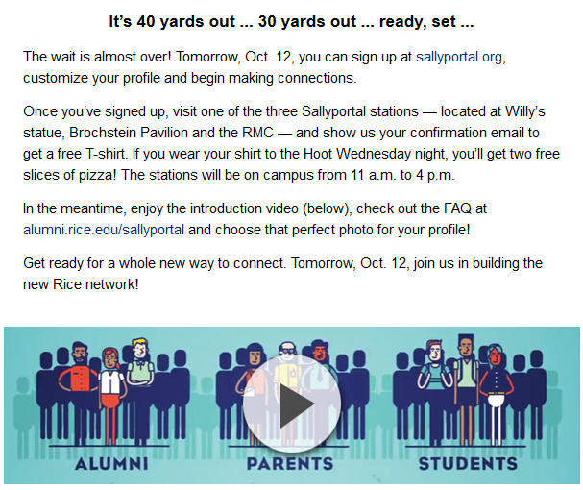
Sallyportal Teaser Email
3 of 3
Students

Slide 34
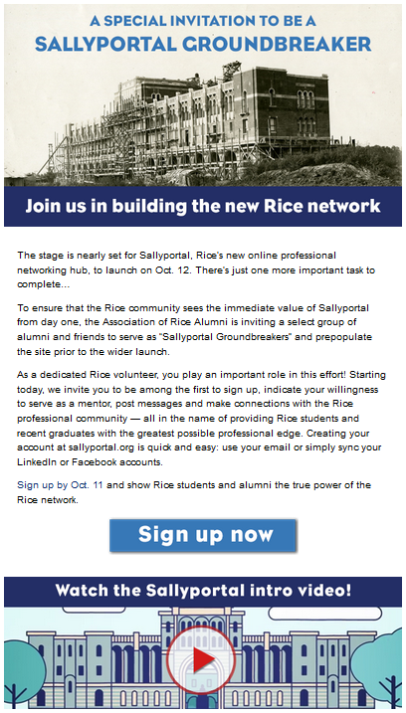
Sallyportal Groundbreaker Email
1 of 3

Slide 35
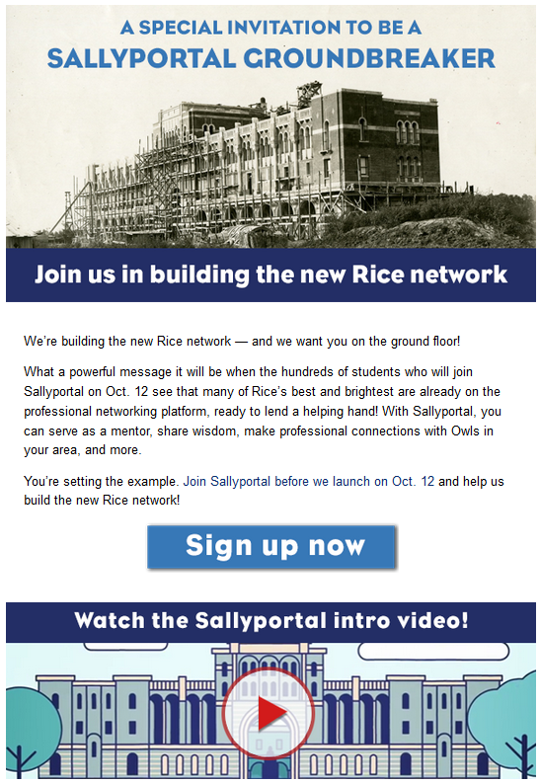
Sallyportal Groundbreaker Email
2 of 3

Slide 36
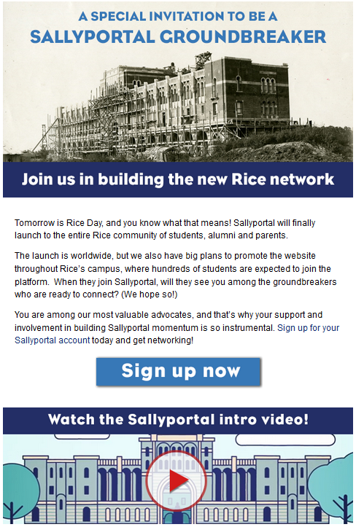
Sallyportal Groundbreaker Email
3 of 3

Slide 37
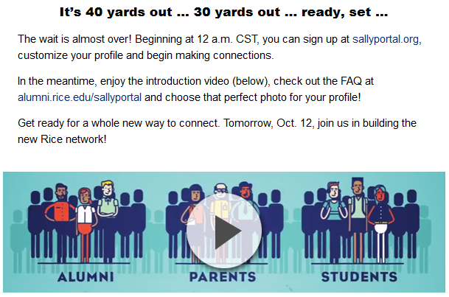
Sallyportal Teaser Email
3 of 3
Non-Students

Slide 38
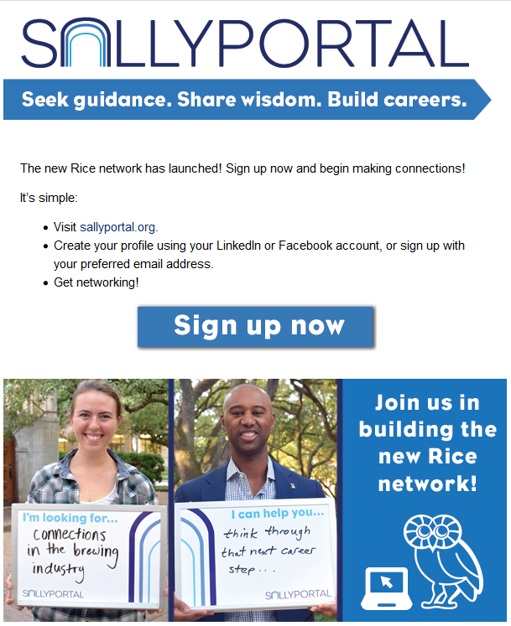
Sallyportal Launch Day Email
1 of 2
Non-Students

Slide 39
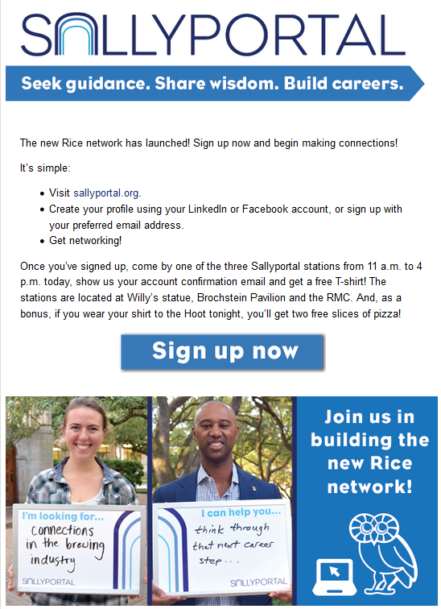
Sallyportal Launch Day Email
1 of 2
Students

Slide 40
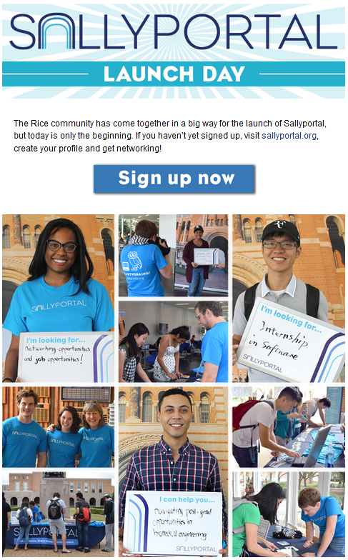
Sallyportal Launch Day Email
2 of 2

Slide 41
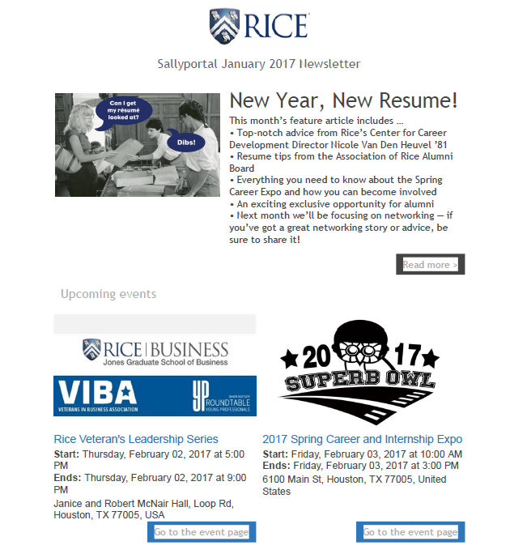
Sallyportal Monthly Newsletter Launched January 2017

Slide 42
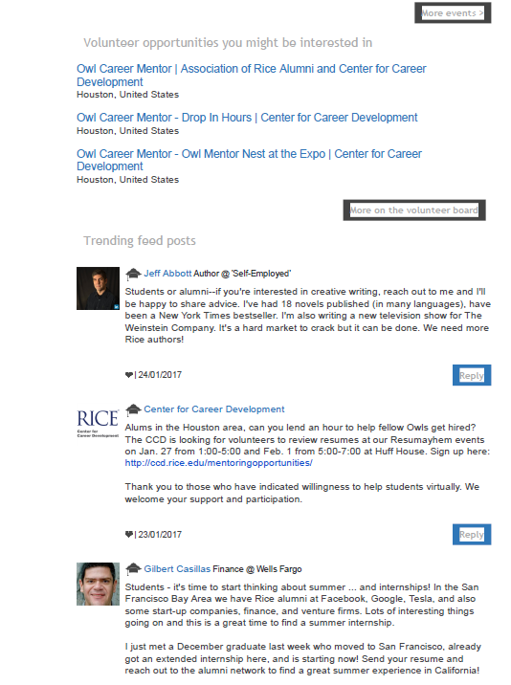

Slide 43
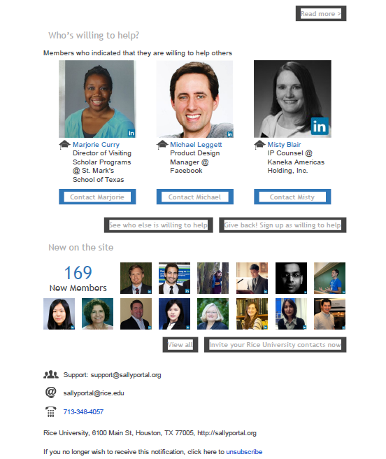

Slide 44
Social Media

Slide 45
Social Media Timeline
# OF POSTS
DATES
PHASES
1: Awareness
Sample posts include: infographic from website, photo of Sallyport with graduates
3
August 22-26
August 29-September 2
September 14 > Teaser email 1 is sent.
Sept. 17-23 Sept. 26-30
Oct. 3-7
Oct. 11
October 12: LAUNCH DAY!
Oct. 17-21
Oct. 24-28
Oct. 31 – Nov. 4
Nov. 7-11
Nov. 14-18
5
2: Prime (“teaser stage”)
Sample posts include: lots of faces, students/alumni holding white boards with messages. B&W photos used for leave-behind cards. Also include tablet photo w/website, infographic video.
5
3: Alert & Activate
All-day, “live” coverage, photos of people signing up, statistics on progress (423 students have signed up and it’s only 5:00 p.m.!), highlight connections.
4: Momentum/Connection
Samples posts include: showing progress, “big name connections”, more humorous B&W photos, thank you’s
5+
Sallyportal Social Media l Schedule & Posting Styles

Slide 46
Important Dates & Other Strategies
Thursday, September 8 or Wednesday, September 14
Sean Cowan to host a private, low-key alumni happy hour
Have alumni take photos with white boards, use for future social media posts
Wednesday, September 14
Board of Trustees meeting
Have members take photos with white boards, use for future social media posts
Opportunity to get “big name alums”
LinkedIn & Owl Mentor Network
Need to develop specific messaging to them. “Get the most out of your account…”
Career edge?
Storify Feed on Landing Page
Publish social media postings from #sallyportal
Use same content on the Sallyportal website
“Wild Card” box could be a photo of someone with a whiteboard and links back to landing page/storify
Sallyportal Social Media l Schedule & Posting Styles

Slide 47
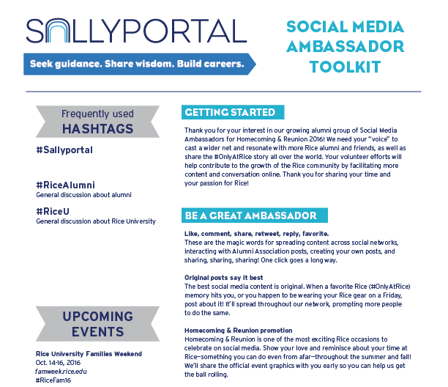
Volunteer Toolkit
This social media toolkit will help our volunteers spread the word on social media. Highlights include proper use of hashtags, when to share posts, etc.
Sallyportal Social Media l Schedule & Posting Styles

Slide 48
INSTAGRAM

Slide 49
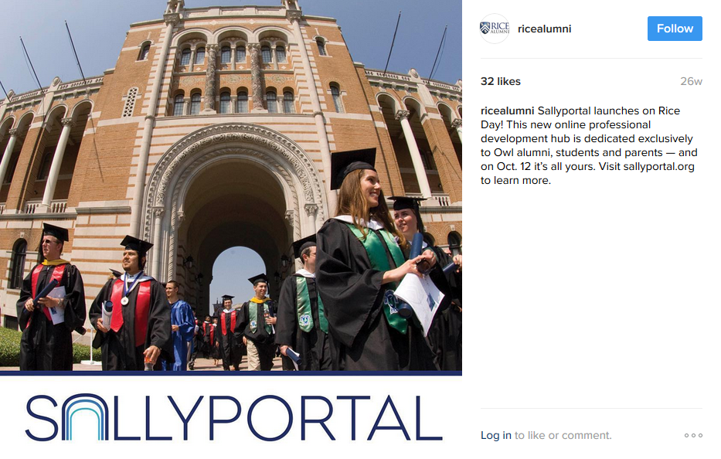

Slide 50
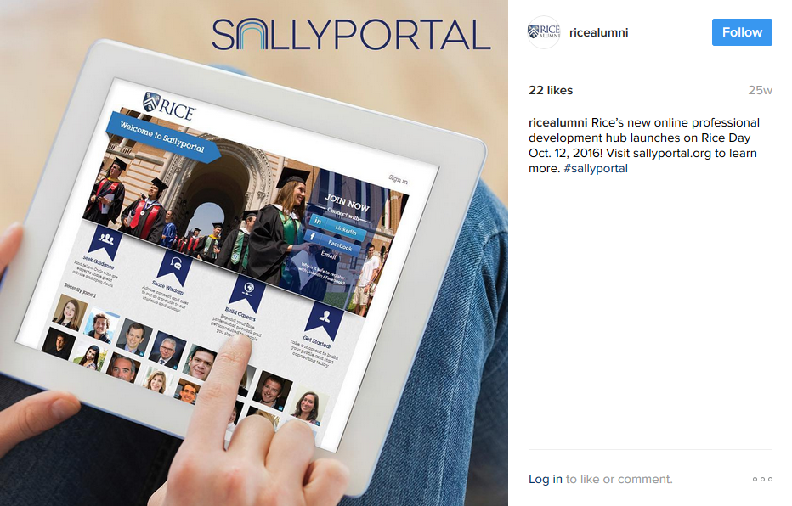

Slide 51
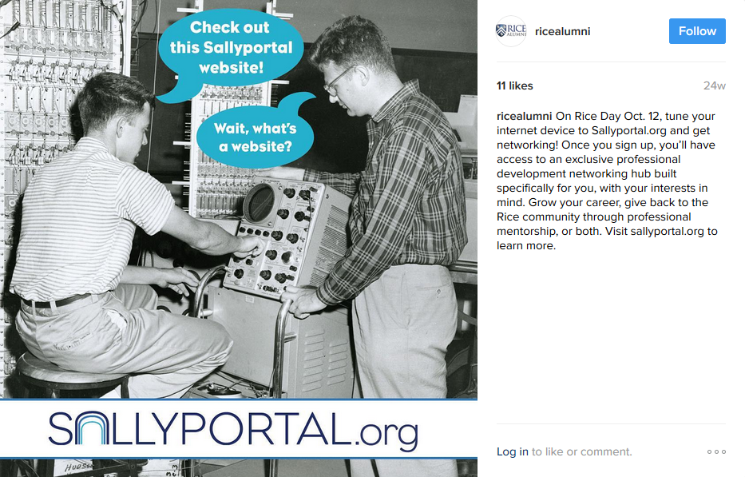

Slide 52
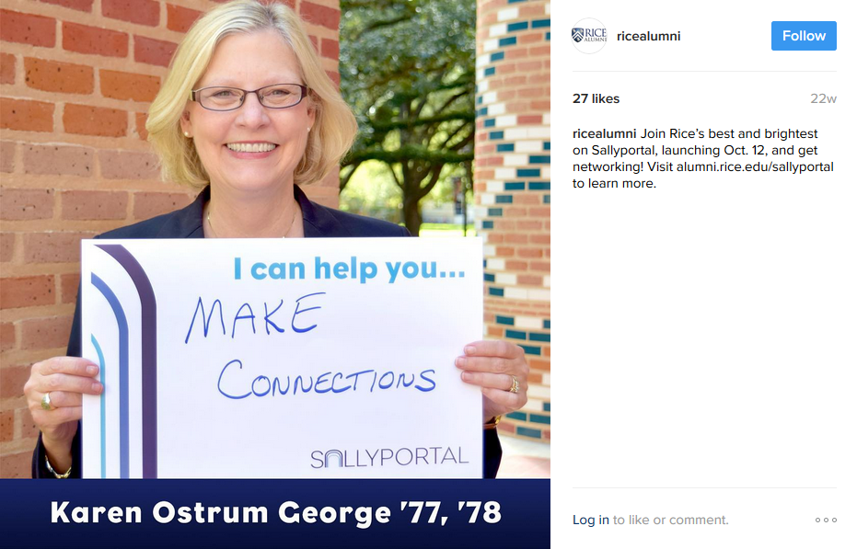

Slide 53
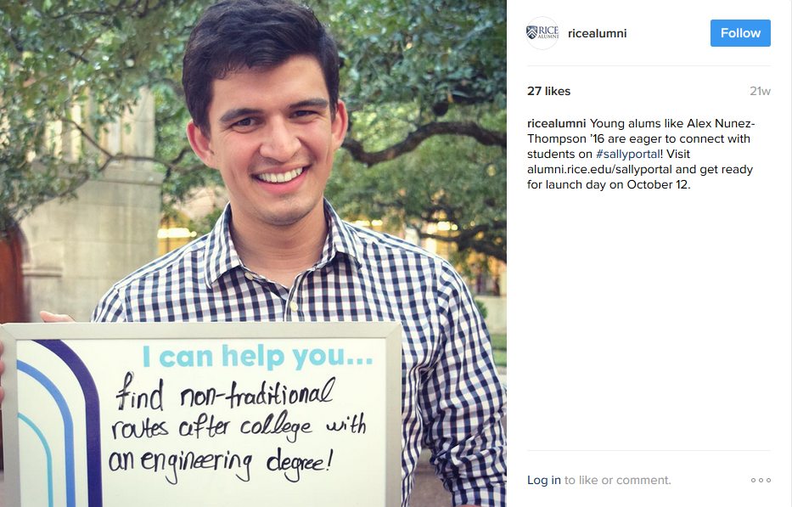

Slide 54
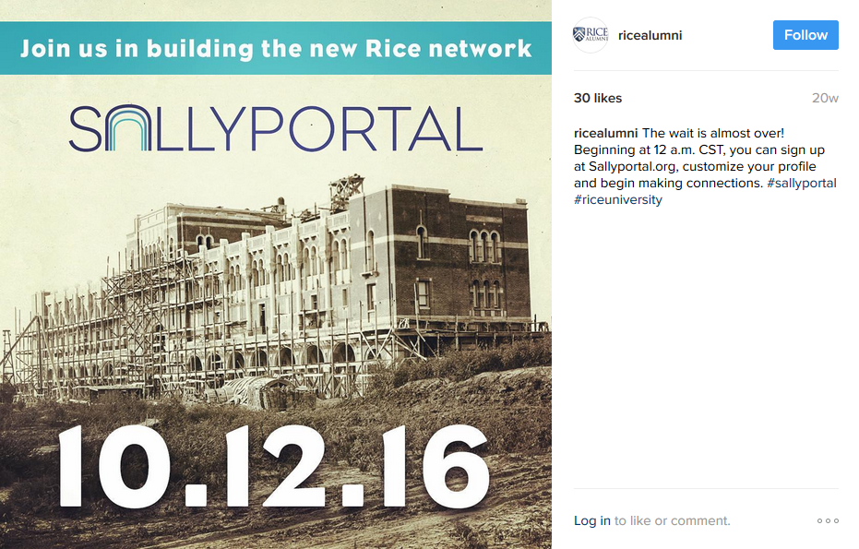

Slide 55
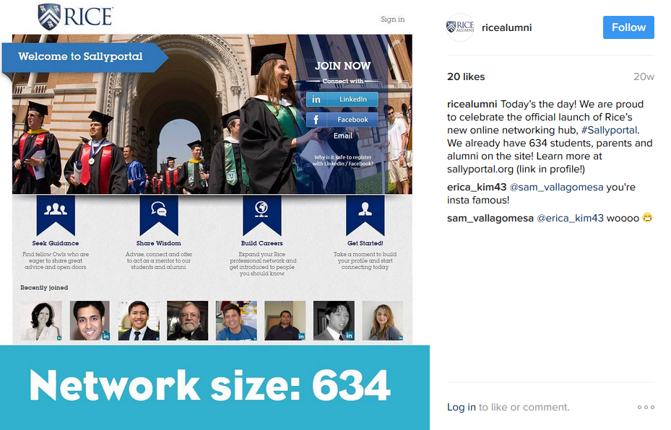

Slide 56
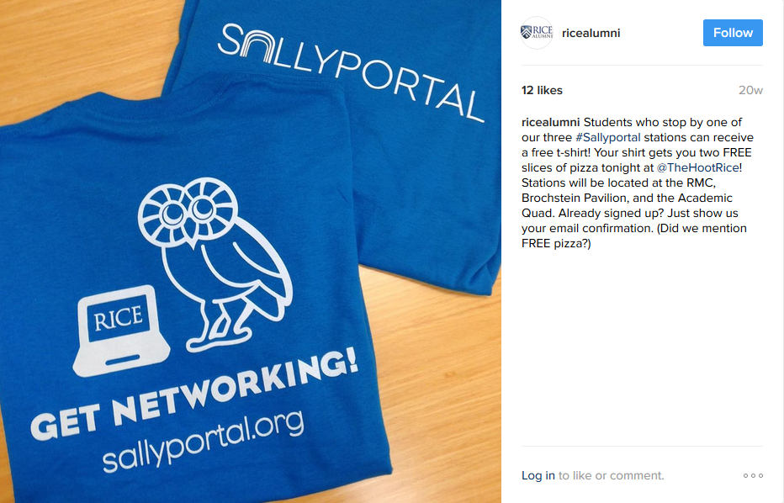

Slide 57
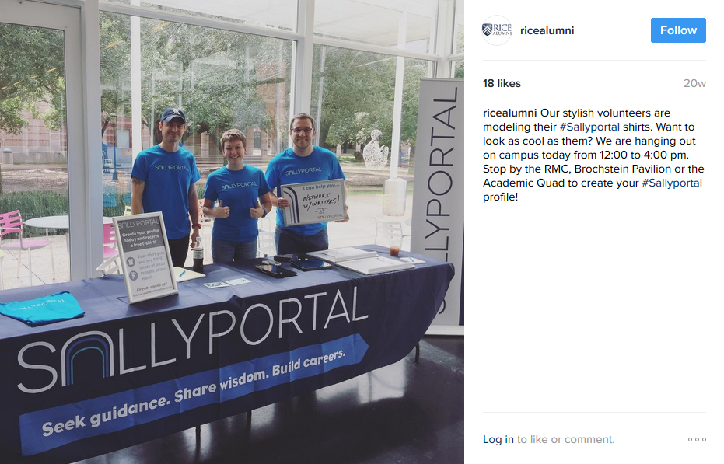

Slide 58
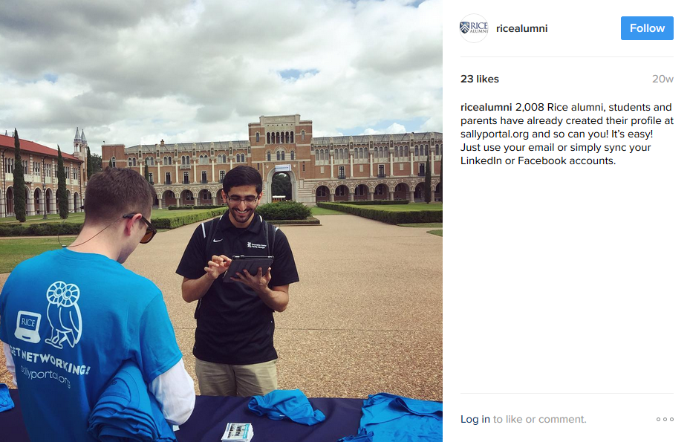

Slide 59
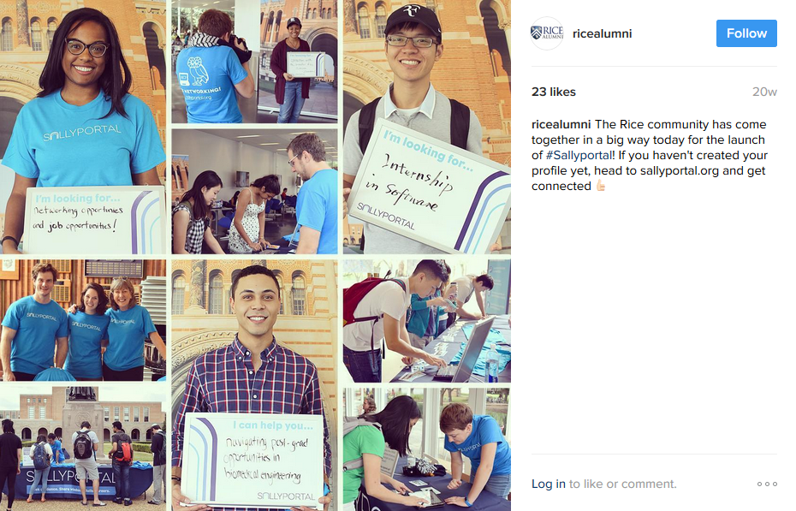

Slide 62
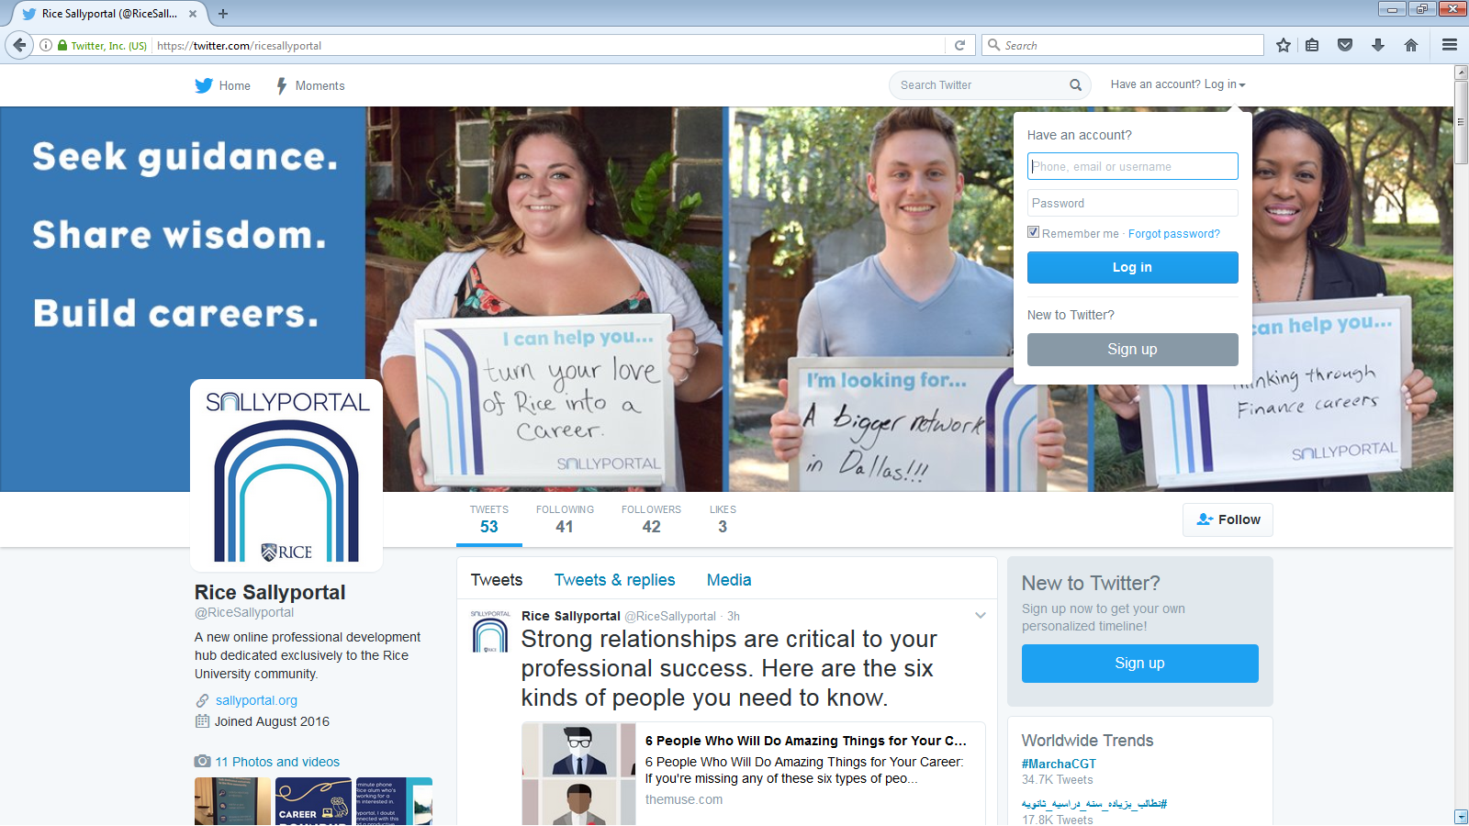
TWITTER

Slide 63
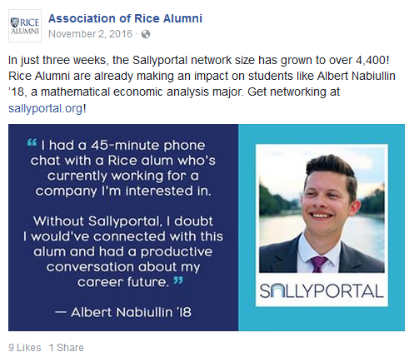
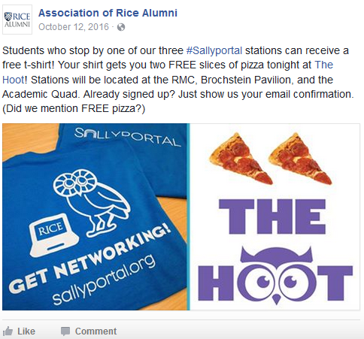
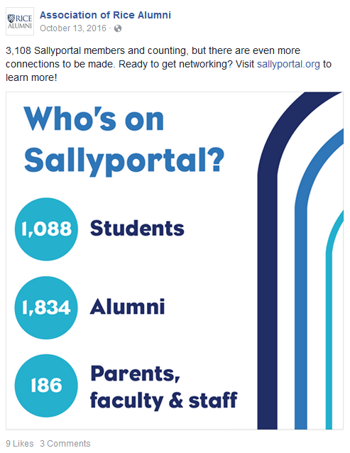
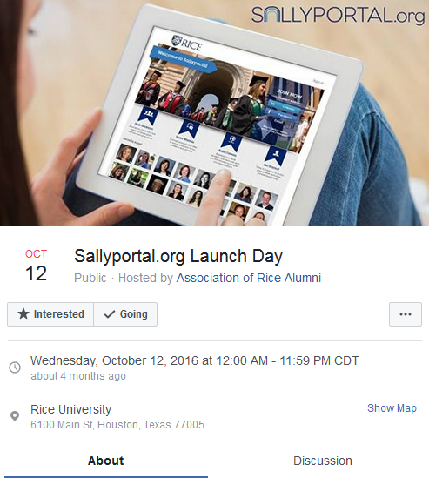
FACEBOOK

Slide 64
SNAPCHAT

Slide 67
THANK YOU

