Slide 1
2017 CASE Circle of Excellence
Rice University

Slide 2
Table of Contents
Planning Slide 3
Outreach Slide 7
Email Slide 16
Web Slide 27
Events Slide 34

Slide 3
Planning

Slide 4
CREATIVE WORK PLAN
PROJECT OVERVIEW:
For the gala weekend, the signature experience will be the gala, but all events and programs happening that weekend will also be marketed to promote attendance and participation throughout the weekend. There will be a robust communications roll out that will include a call for nominations/save the date, printed invitations approximately 8 weeks in advance, email invitations, paid and promoted social media posts, and event collateral design such as slides, videos, banners, and the awards themselves for the honorees. In addition to ARUBA specific emails and marketing, the weekend will be promoted in Houston and all-alumni newsletters leading up to the event to build awareness and encourage participation among the greater Rice alumni and friends community.
PROJECT GOALS:
Reengage alumni, plug into Rice
Endowment legacy
Inclusive of faculty, including new faculty
Connect with students, opportunity for them to connect with alumni
Celebrate from where we came and where we are going
Create an archive for milestones

Slide 5
KEY COMMUNICATIONS DATES: June 16 Website Phase I June 24 RFP for Gala Video(s) Complete June 22 Email 1 of 5 July 11 Commission Update Email July 15 All Alumni Newsletter July 18 Campus Email Aug 5 Website Phase II Aug 8 Print Invitation Drops in Mail Aug 8 Volunteer Outreach Toolkit Ready Aug 10-11 Email 2 of 5 Aug 12 DC & NYC Regional Emails Aug 19 Bay Area Regional Email Aug 26 Houston Events Digest Aug 29-Sept 2 Website Phase III Sept 2 Austin & Dallas Regional Emails Sept 5 Email 3 of 5 Sept 5-12 Rice News Sept 23 Email 4 of 5 Sept 28 Event Program Delivered Sept 28 Final Video(s) Delivered Sept 30 Houston Events Digest Sept 30-Oct 2 ARUBA Reunion Weekend 2016 Oct 7 Email 5 of 5

Slide 6
DELIVERABLE | PURPOSE/TASK | SEGMENT | DEADLINE | NOTES
Email 1 of 5 | Save the date for gala; nominations open; recap of year-to-date | ARUBA; Commission | June 22
All Alumni Newsletter | Save the date; nominate | All | July 8-15 | Reminder to nominate
Campus email | Nominate | All-Depts | July 18
Email 2 of 5 | Email invitation w/ link to registration page | ARUBA, Commission | August 10-11 | Send shortly after print invitation drops
DC & NYC regional emails | Blurb announcing registration is open | DC & NYC alums | August 12
Commission update | Announce winners prior to broader announcement | Volunteers | TBD
Bay Area regional email | Blurb announcing registration is open | Bay Area alums | Aug. 19
Commission update email | Reminder to nominate; save the date | Commission | July 11 Mid-late August | Per Dan 6/27: The commission update can go in mid-late August as a “kickoff to the fall” type of message
Houston event digest | Highlight gala as a signature event | Houston alumni | Aug. 26
Austin and Dallas regional emails | Blurb announcing registration is open | Austin and Dallas alums | Sept. 2
Email 3 of 5 | Announce award-winners and link to registration | ARUBA, Commission, Others TBD | September 5 | Highlight award winners with brief bios; 2nd reminder to register
Rice News | Announcement of award winners | Subscribers | September 5-12
Email 4 of 5 | Last chance to register | ARUBA, Commission, Others TBD, minus registrants | September 23 | Last chance: approx. one week out of event
Houston event digest | Reminder for weekend; walkups accepted (TBD) | Houston alumni | September 30
Email 5 of 5 | Thank you and survey | Attendants of gala | Oct. 7 | Include any notes about remaining events for 50 year celebration; link to photos

Slide 7
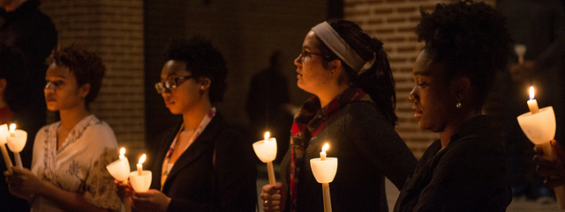
Student and Community Outreach

Slide 8
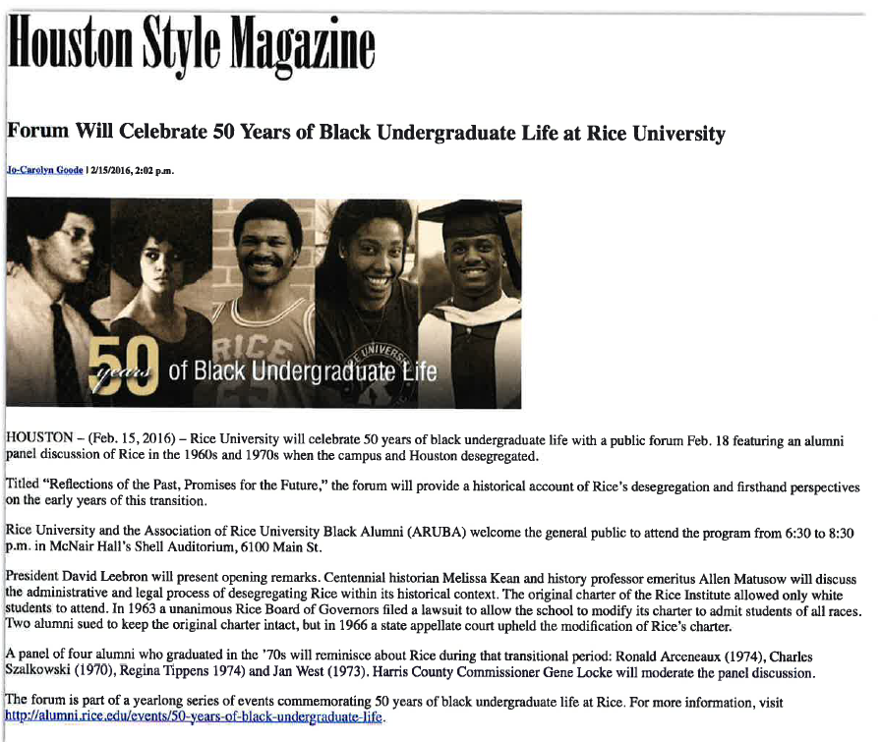

Slide 10
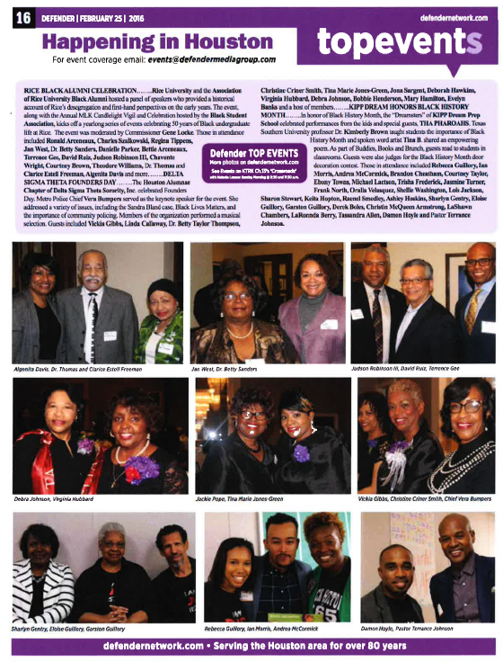
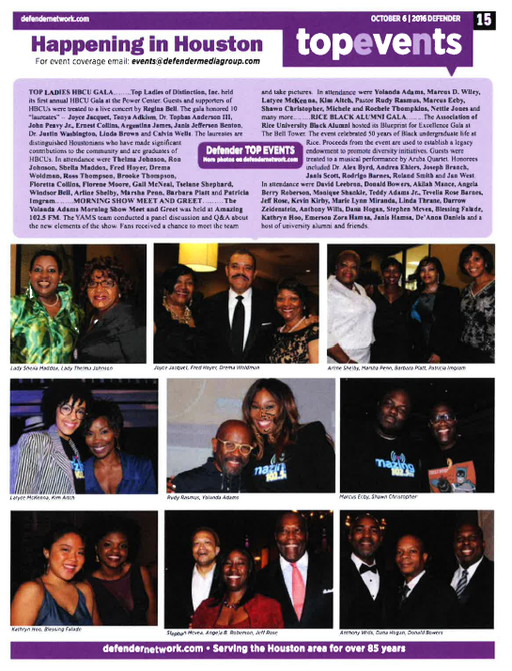

Slide 11
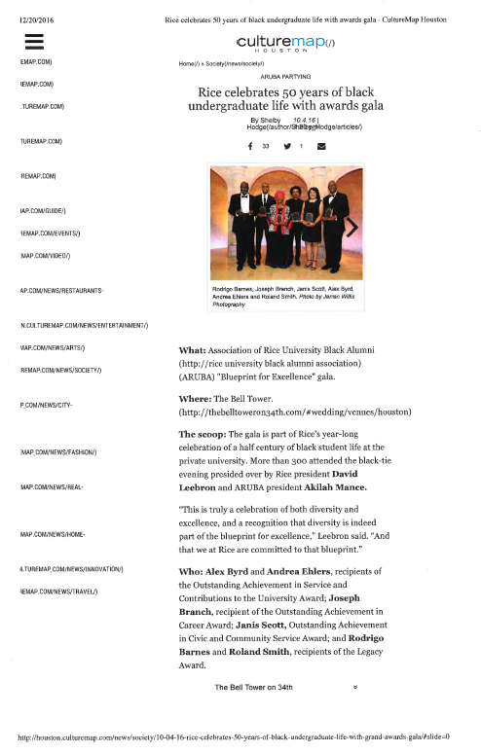

Slide 13
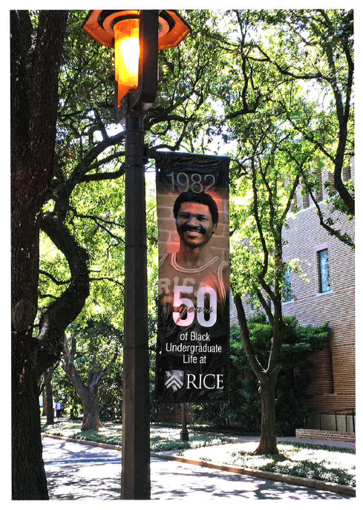
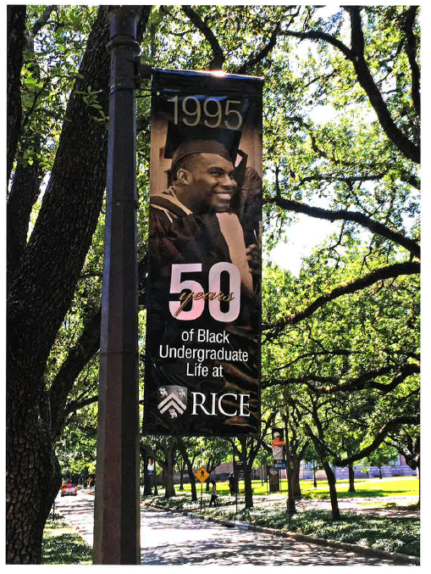

Slide 14
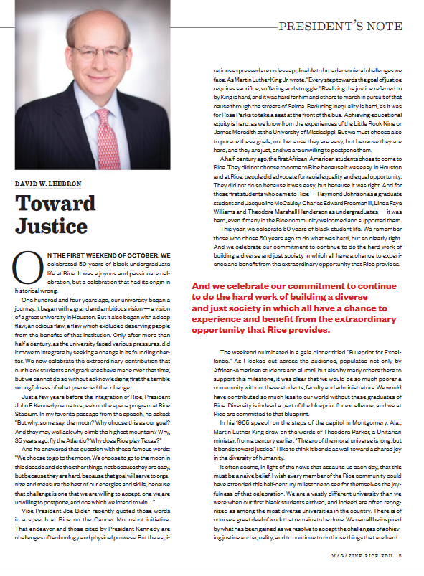
RICE MAGAZINE, FALL 2016 HTTPS://ISSUU.COM/RICEUNIVERSITY/DOCS/FALL2016RICEMAG_ISSUU

Slide 15
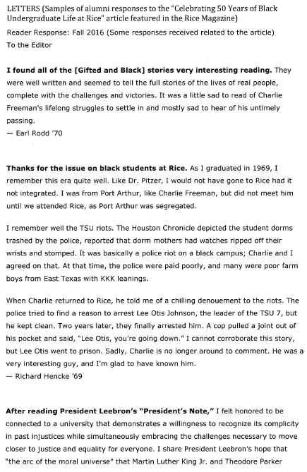
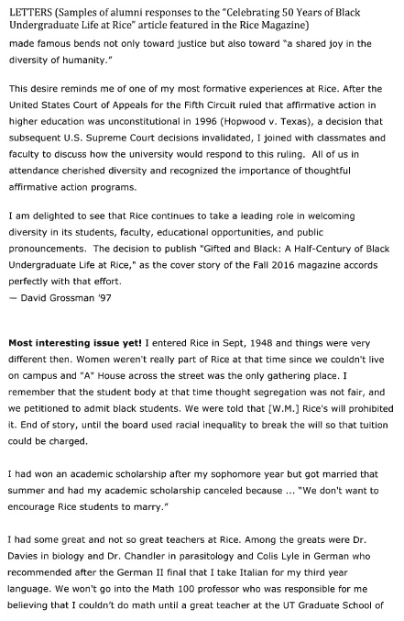

Slide 16
Email

Slide 17
ARUBA 50 Years Celebration
Email 1 of 3

Slide 18
ARUBA 50 Years Celebration
Email 2 of 3

Slide 19
ARUBA 50 Years Celebration
Email 3 of 3

Slide 20
ARUBA 50 Years Athletics
Emails 1 to 3

Slide 21
ARUBA Gala
Email 1 of 5

Slide 22
ARUBA Gala
Email 2 of 5

Slide 23
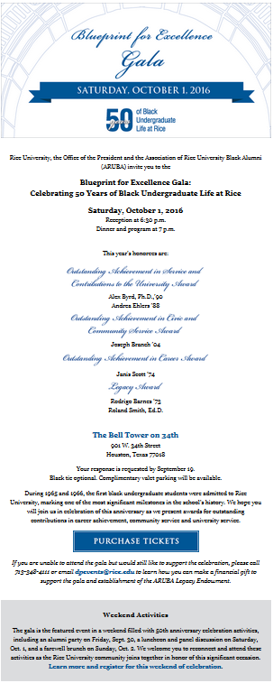
ARUBA Gala
Email 3 of 5

Slide 24
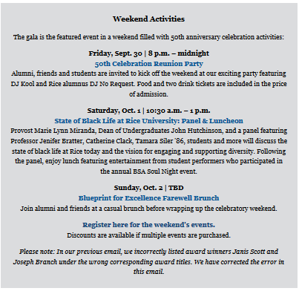
ARUBA Gala
4 of 5

Slide 25
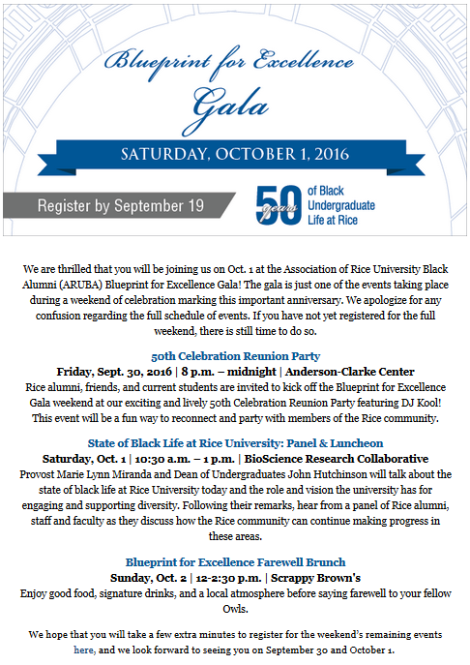
ARUBA Gala
Registrant Email

Slide 26
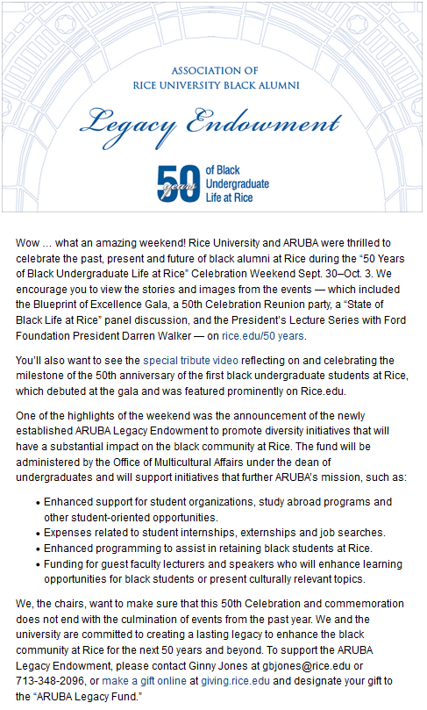
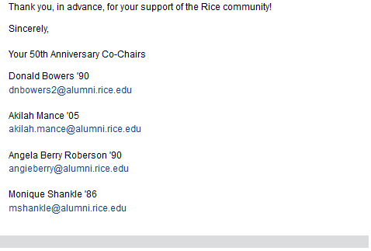
ARUBA Gala
5 of 5

Slide 27
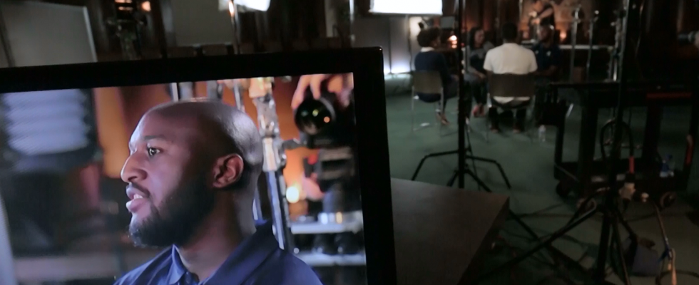
Web

Slide 28
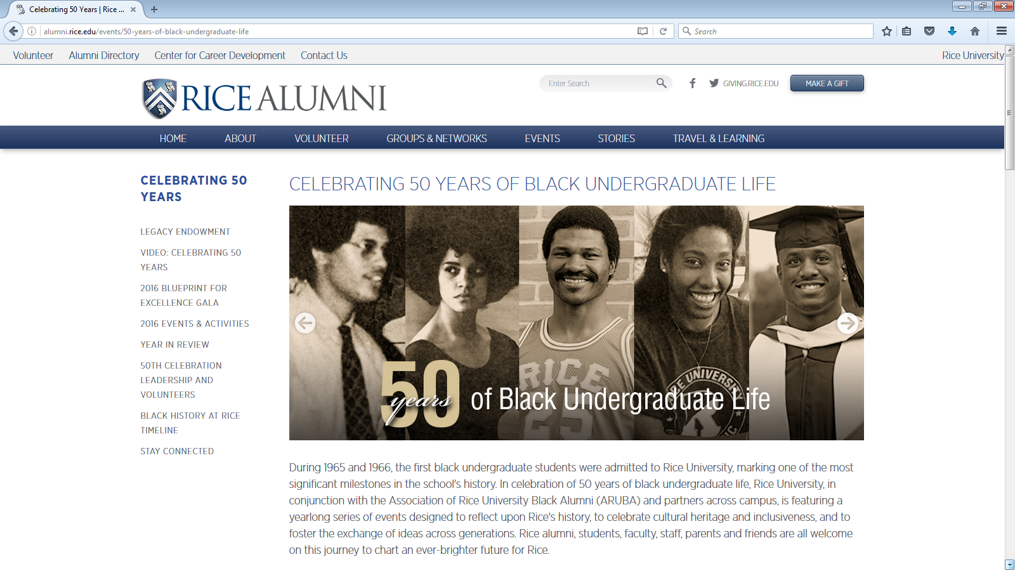
CELEBRATING 50 YEARS OF BLACK UNDERGRADUATE LIFE HTTP://ALUMNI.RICE.EDU/EVENTS/50-YEARS-OF-BLACK-UNDERGRADUATE-LIFE

Slide 29
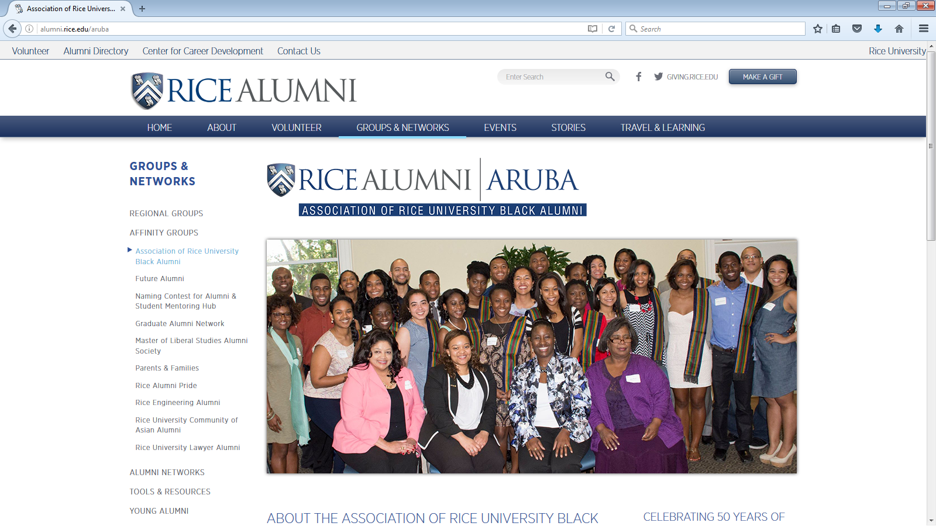
ARUBA HTTP://ALUMNI.RICE.EDU/ARUBA

Slide 30
VIDEO: CELEBRATING 50 YEARS HTTP://ALUMNI.RICE.EDU/EVENTS/50-YEARS-OF-BLACK-UNDERGRADUATE-LIFE/VIDEO-CELEBRATING-50-YEARS-OF-BLACK-UNDERGRADUATE-LIFE-AT-RICE

Slide 31
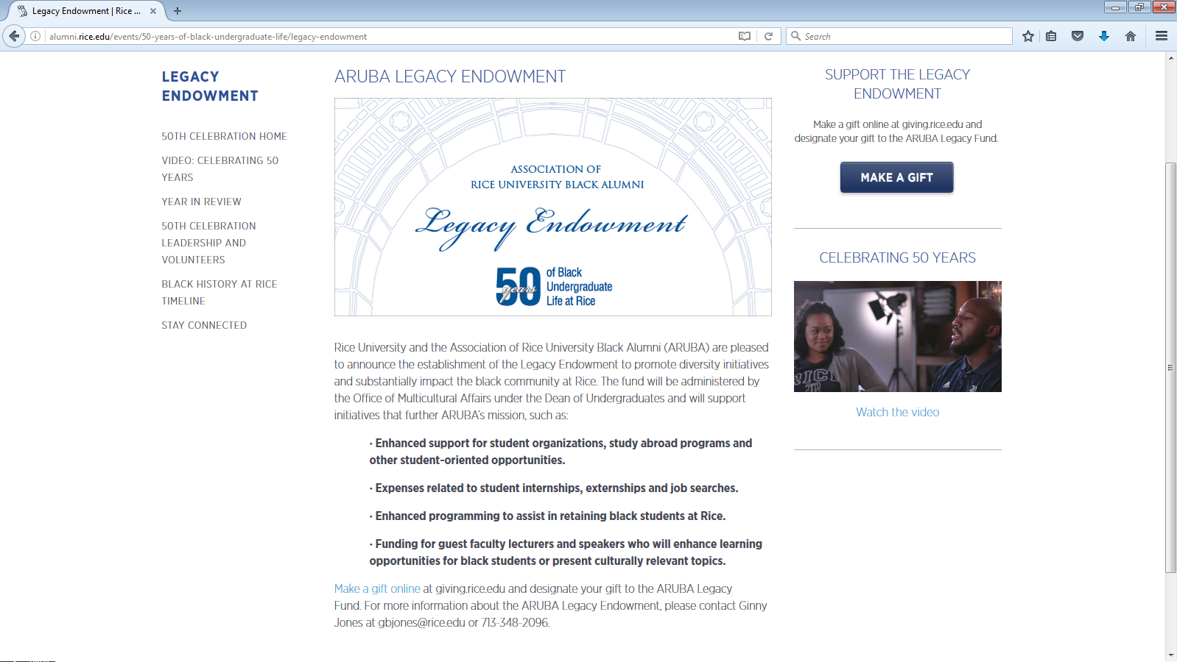
ARUBA LEGACY ENDOWMENT HTTP://ALUMNI.RICE.EDU/EVENTS/50-YEARS-OF-BLACK-UNDERGRADUATE-LIFE/LEGACY-ENDOWMENT

Slide 32
BLACK HISTORY AT RICE TIMELINE HTTP://ALUMNI.RICE.EDU/BLACK-HISTORY-AT-RICE-TIMELINE

Slide 33
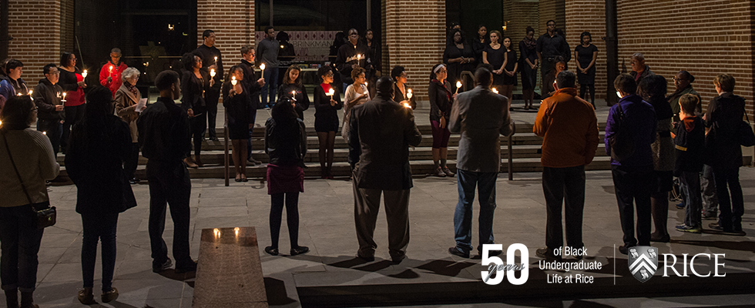
Web Banners

Slide 34
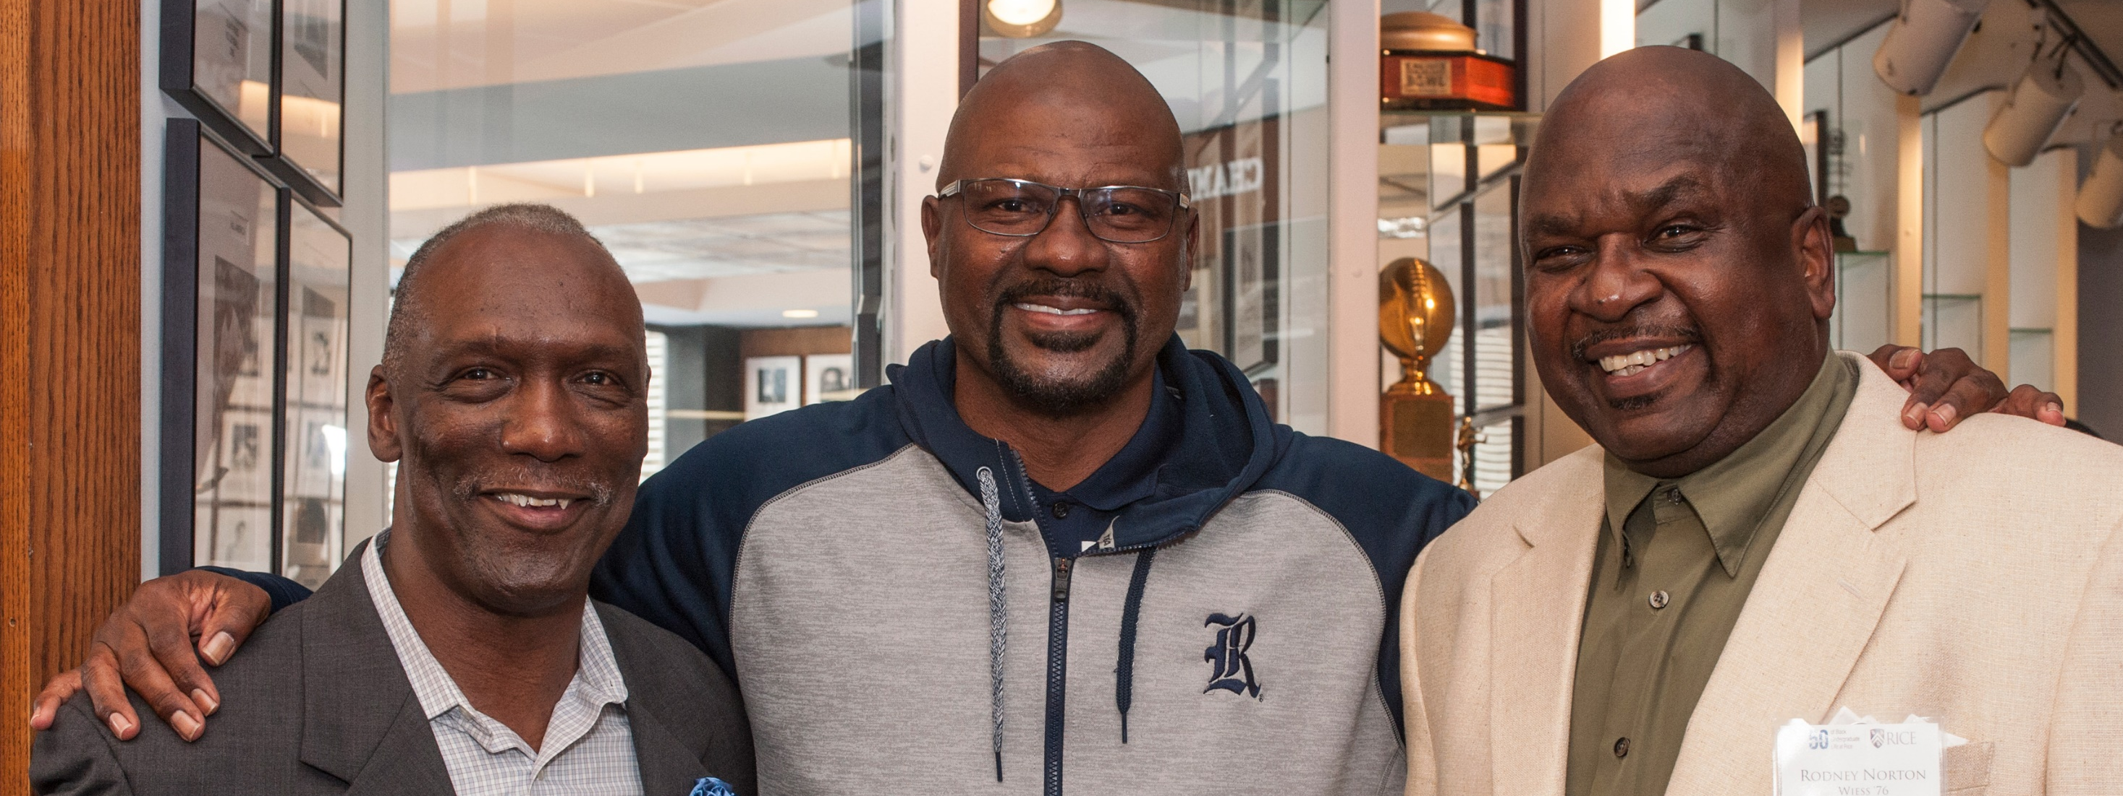
Events

Slide 35
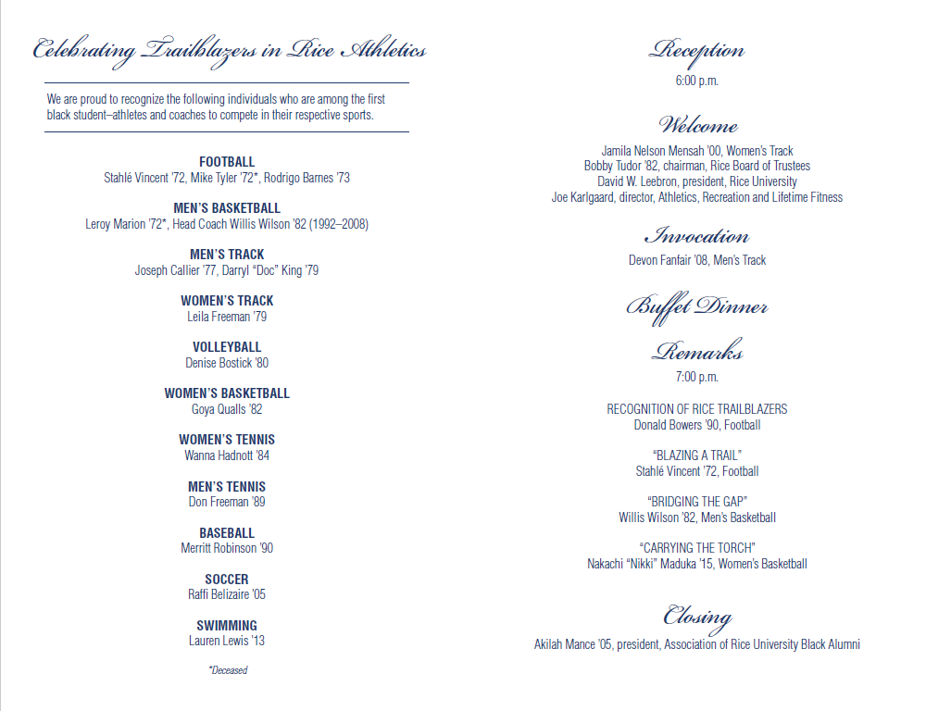
TRAILBLAZERS IN RICE ATHLETICS PROGRAM

Slide 36
Gala Print Invitation

Slide 37
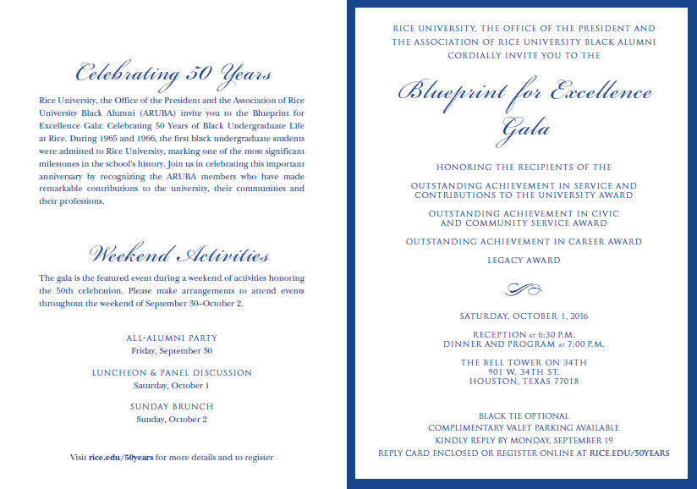

Slide 38
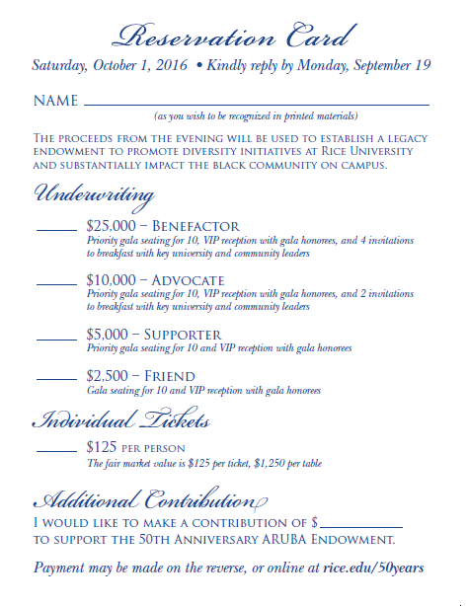
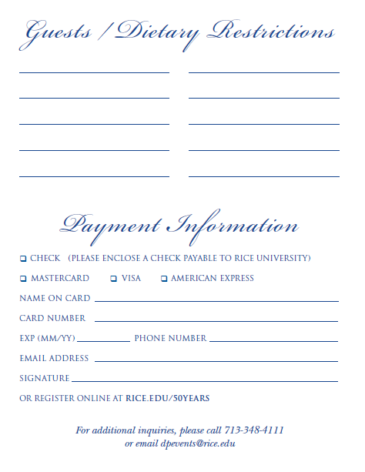

Slide 39
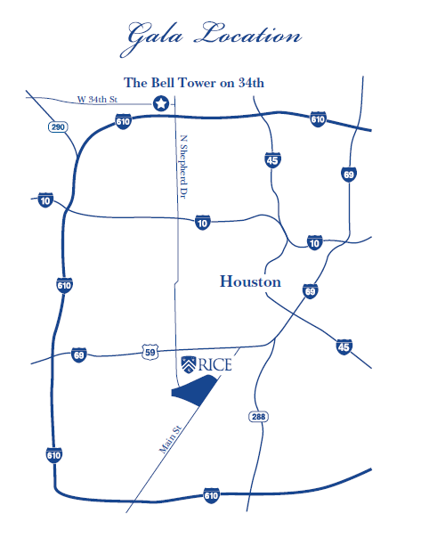

Slide 40
BLUEPRINT FOR EXCELLENCE Gala Program

Slide 41
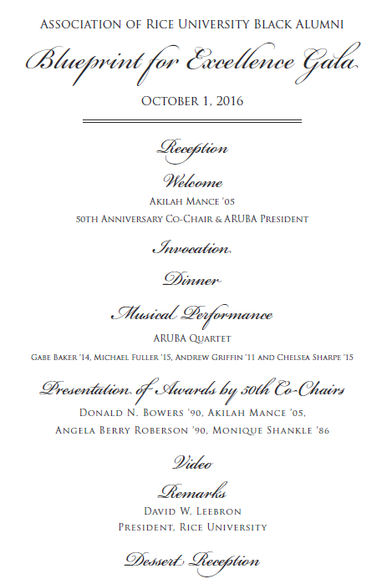

Slide 42
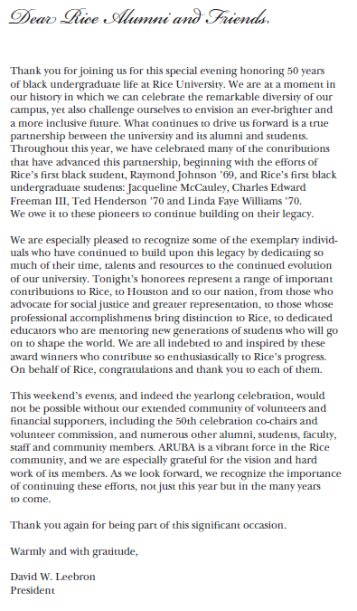

Slide 43
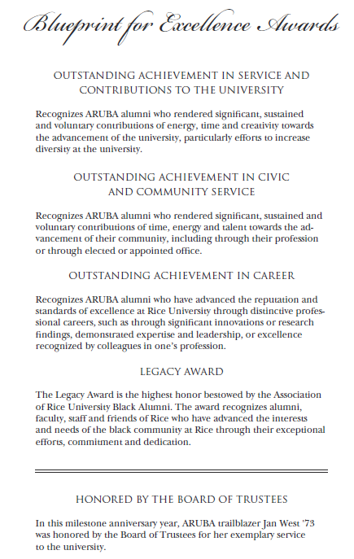

Slide 44
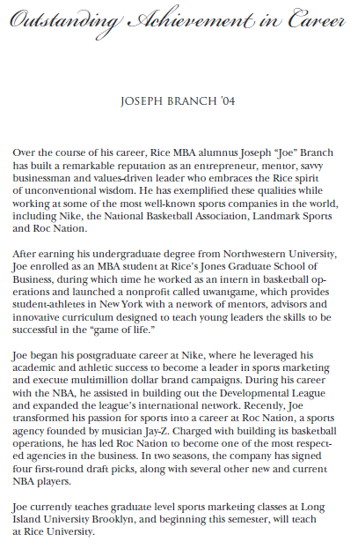
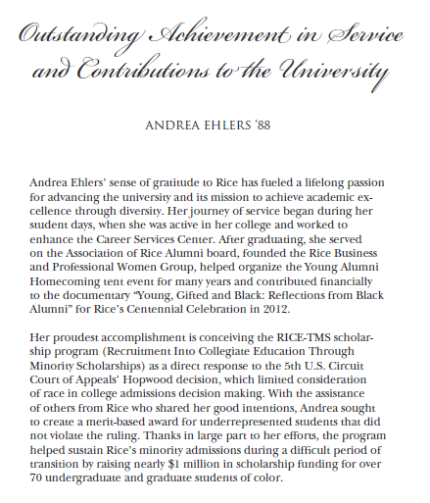

Slide 45
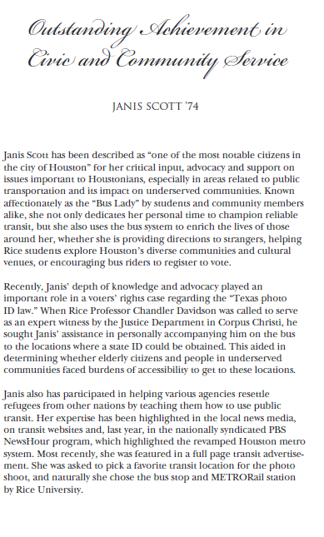
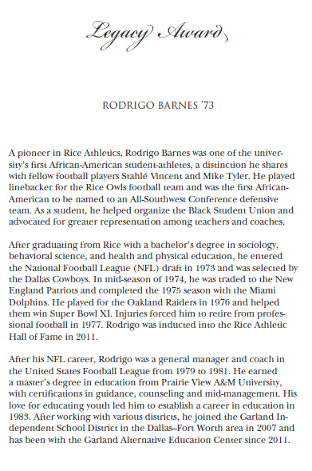

Slide 46
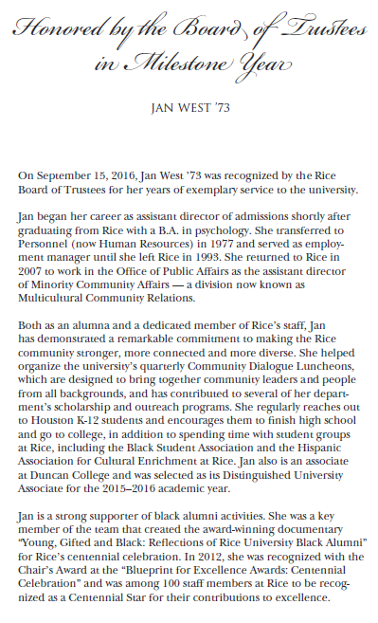

Slide 47
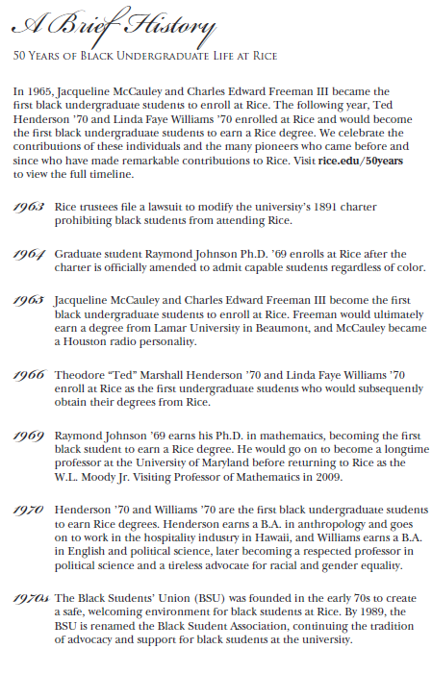
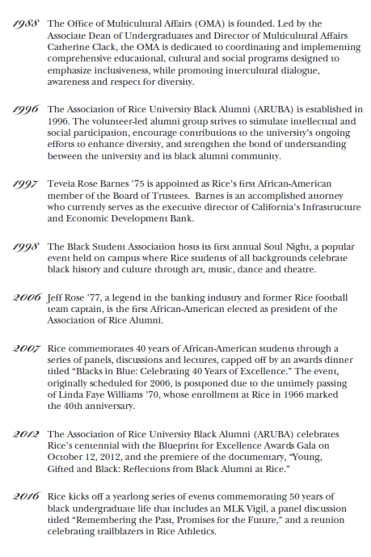

Slide 48
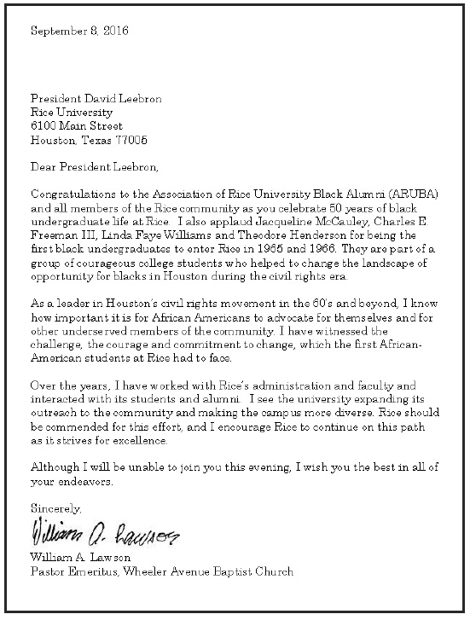

Slide 49
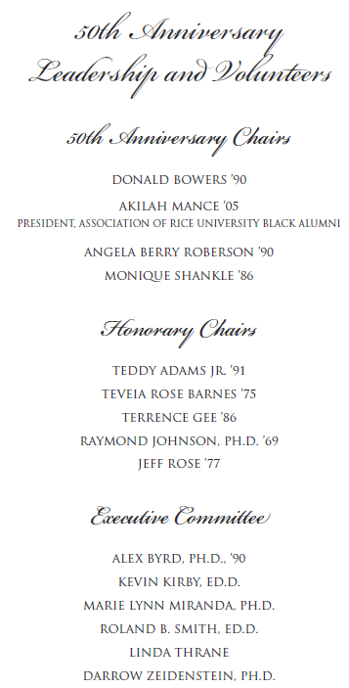

Slide 50
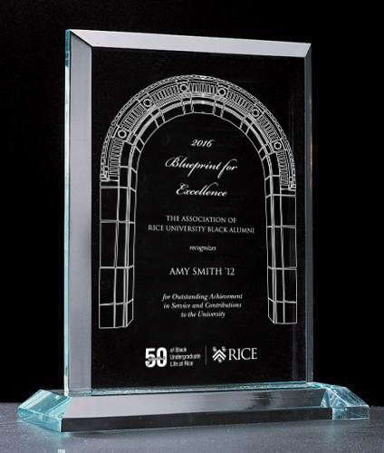
Gala Award

Slide 51
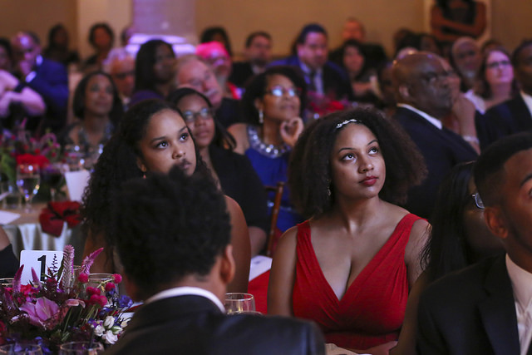
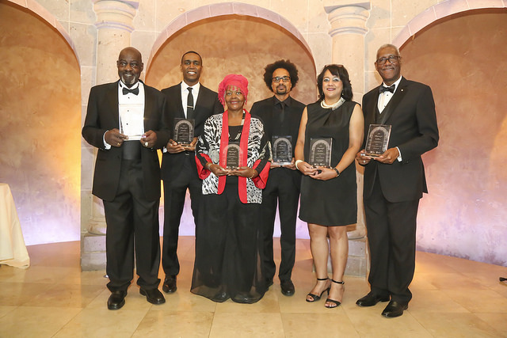
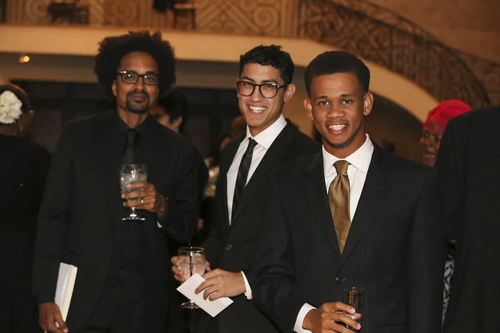
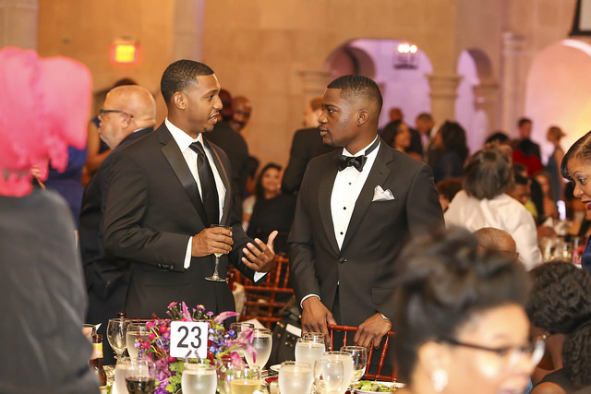
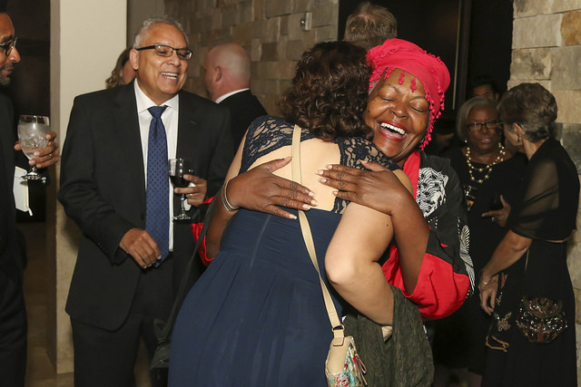
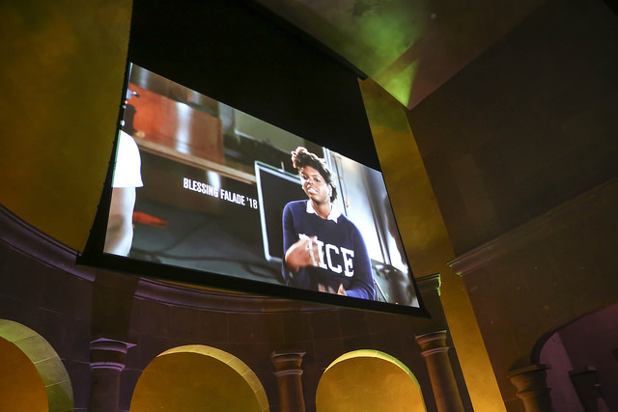
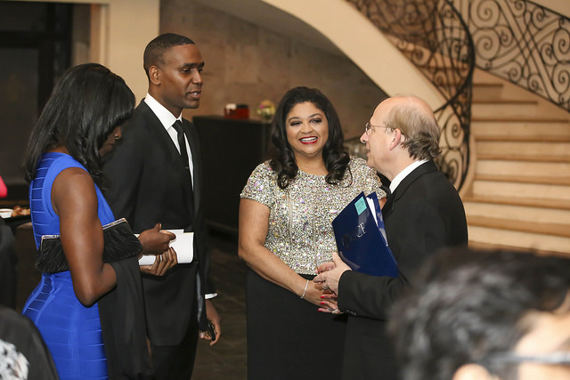
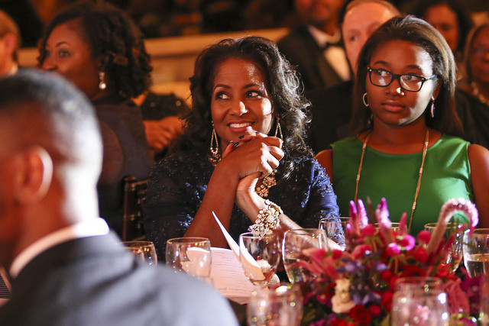
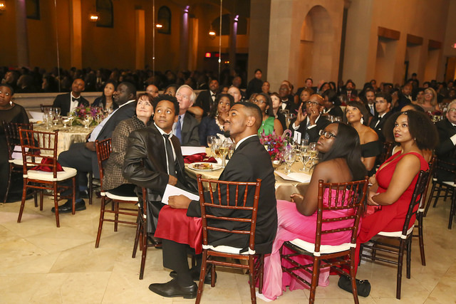
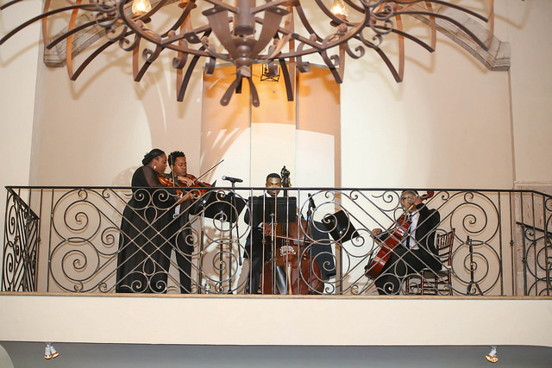

Slide 52
EVENT PHOTOS
For more event photos, please visit:
https://www.flickr.com/photos/ricepublicaffairs/26170425361/in/album-72157666659626791
and
https://www.flickr.com/photos/ricepublicaffairs/albums/72157674732413625

Slide 53
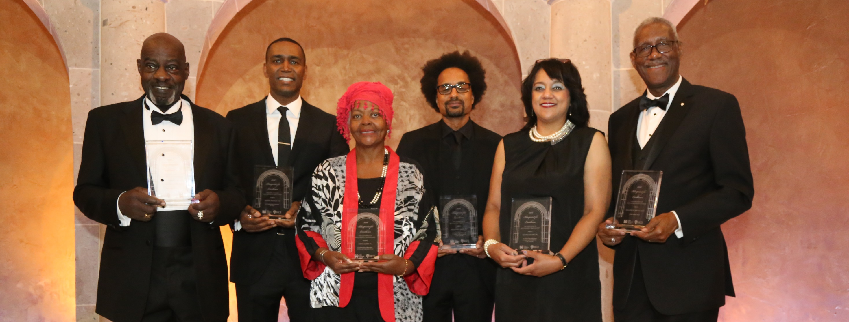
THANK YOU

