Slide 1
Syracuse University Brand Image Campaign
Division of Marketing and
Communications

Slide 2
Overview
In order to broadly share the defining strengths of Syracuse University (SU) across schools and programs, to clarify what Syracuse University stands for, how it’s different, and to amplify Syracuse University’s expressions and experiences for greater recognition, relevance, revenue and reach coinciding with our brand launch, this campaign looks an integrated brand campaign for Syracuse University (SU).

Slide 3
Brand Campaign Goals
The overall marketing goal is increasing the University brand reputation by targeting specific audiences by focusing on recruitment, retention, and alumni and donor support.
Measurement focus: comparison to historical and industry benchmarks (e.g., CTRs, CPCs, CPM, video views/viewability, website traffic and swipe ups), website traffic, audience growth rate, and applause rate.
Target audiences: prospective students and parents/families of prospective students, high school counselors (recruitment), current students and parents/families of current students (retention), and alumni and donors (donations and support).

Slide 4

Visual Identity
Syracuse University embarked on a University-wide initiative to clarify what we stand for, how we’re different and why audiences should engage with us.
As we look to the future of Syracuse University, we are all responsible for telling our story in a clear, compelling and cohesive way.
Shared resources can help us all understand, own and implement our identity with consistency, so we can realize our One University vision – and the full potential of the entire Syracuse University community.

Slide 5
Campaign Strategy
To achieve our campaign goals, we will leverage a mix of online and offline channels, targeting specific audience demographics and interests, allowing for a multi-touchpoint strategy.
Paid Social (Facebook, Instagram, YouTube, Twitter, Snapchat, LinkedIn): High reach to increase position understanding among the identified target audiences. Different platforms will be used to target specific targets, e.g., Snapchat for high school students.
Digital Display Advertising: High reach, high frequency to build top-of-mind brand position and understanding among the target groups.
Paid Search (Google): Strong channel for hyper-targeting prospects in specific geographies who are actively searching for majors/minors or other programs.
Out-of-Home (Syracuse Airport Advertising): High traffic channel for reaching mass audiences and building exposure to the SU brand and message, especially in the local SYR Airport.
Print: To reach and build awareness for the alumni/donor target group across specific geographies and utilizing MNI’s Business Network package.
Video: Our video strategy would lean heavily on :06 bumpers and :15 pre-roll ads on YouTube targeting students and parents and be complemented by a small :30 digital TV buy to target parents and broader audiences.
CTV/OTT: Similar to traditional expensive television buys in terms of coverage, CTV/OTT is a more cost-effective way to reach targeted audiences for high impressions.

Slide 6
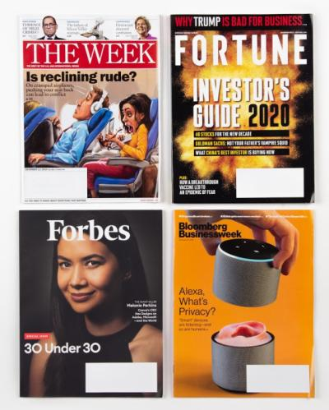
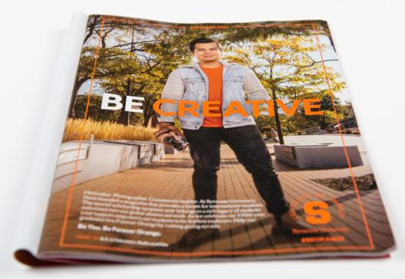
Print Ads (Fortune, The Week, Entrepreneur, Bloomberg Business Week)

Slide 7
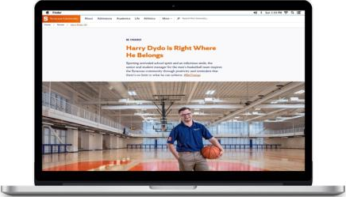
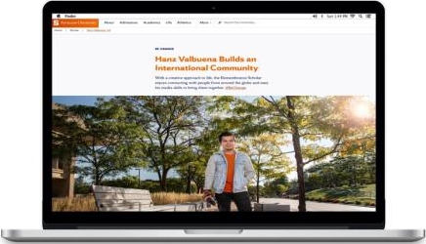
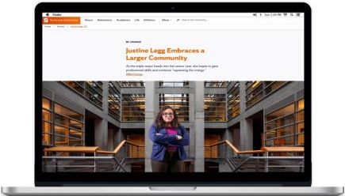
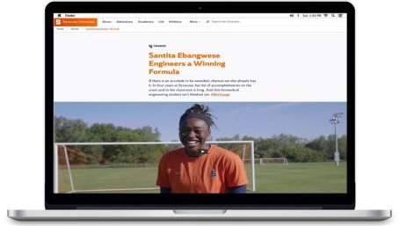
Student Profile Stories on Syracuse.edu/About
LINK
LINK
LINK
LINK

Slide 8
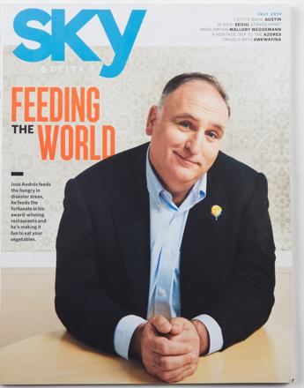
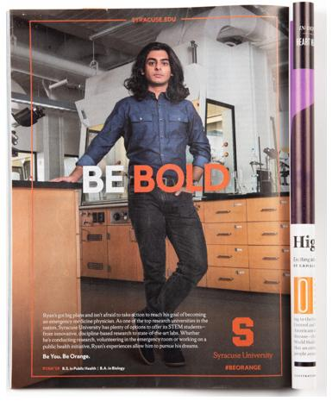
Print Ads (Delta Sky Magazine)

Slide 9
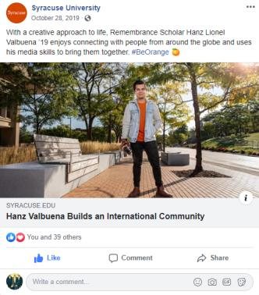
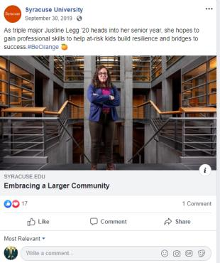
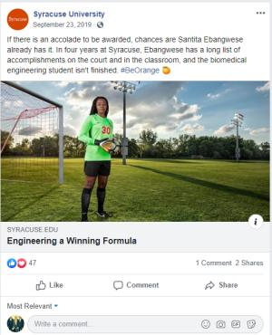
Facebook

Slide 10
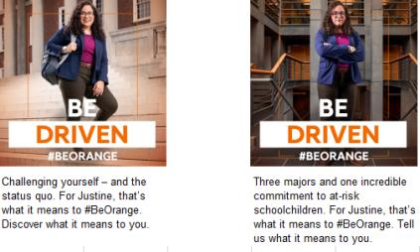
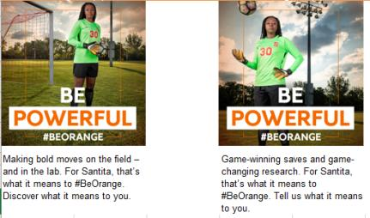
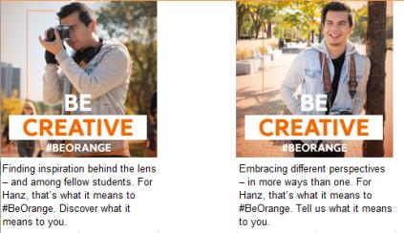
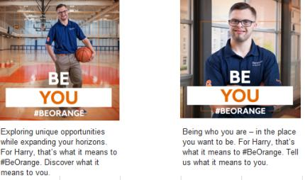
Instagram

Slide 11
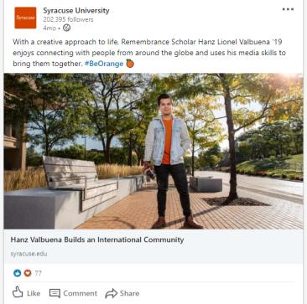
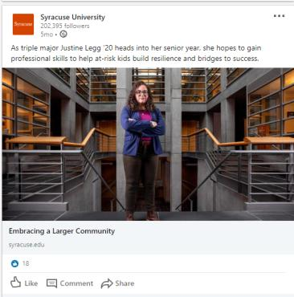
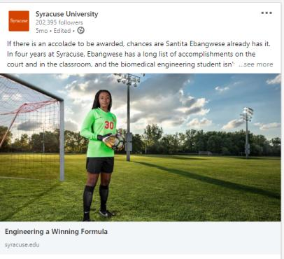
LinkedIn

Slide 12
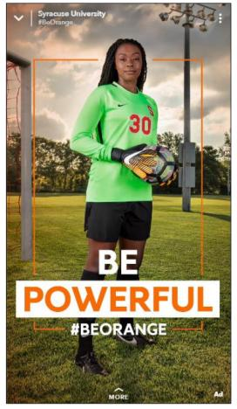
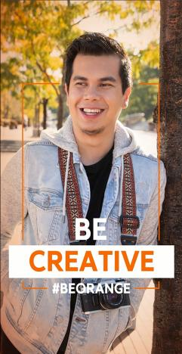
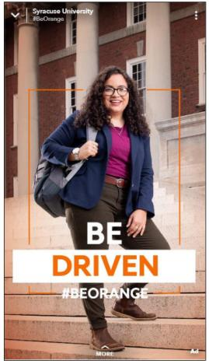
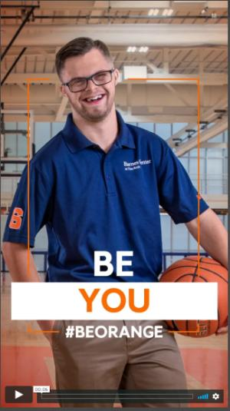
Snapchat

Slide 13
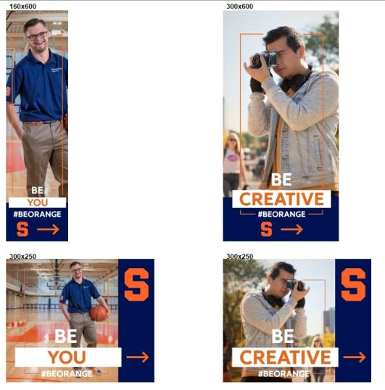
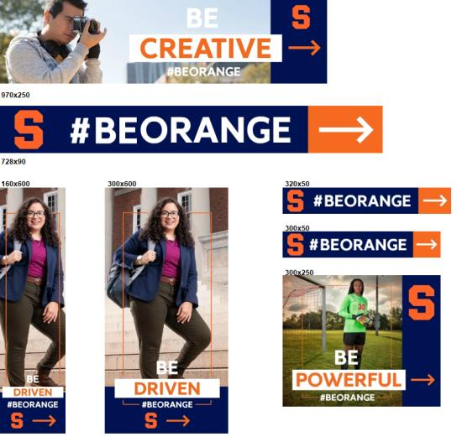
Programmatic Display Banner Ads

Slide 14
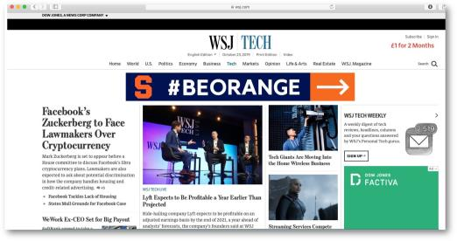
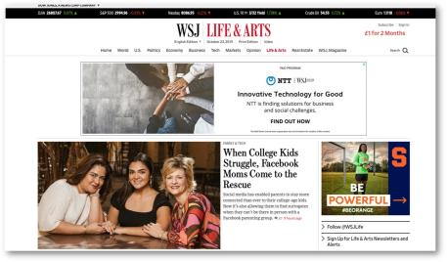
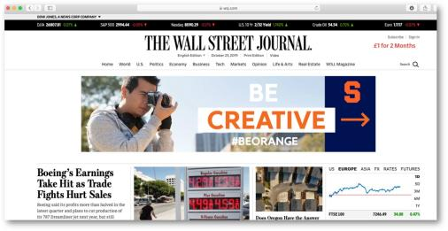
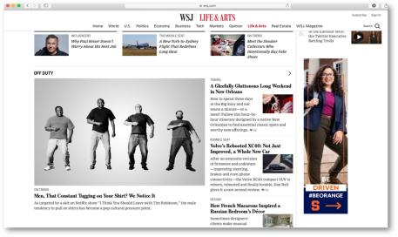
Wall Street Journal Paid Ads

Slide 15
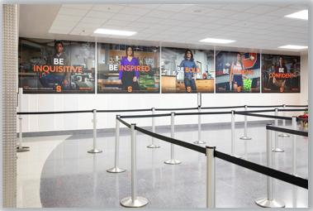
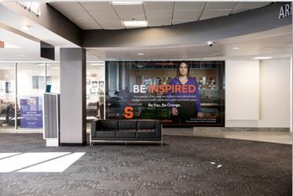
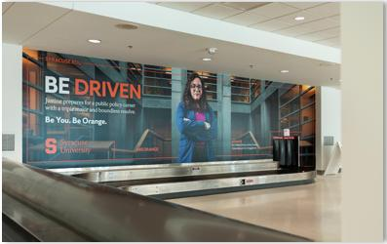
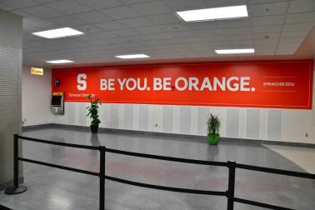
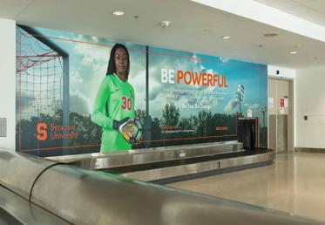
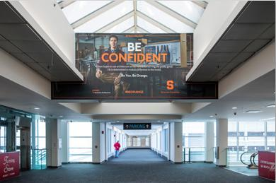
Airport (Syracuse Hancock International Airport)

Slide 16

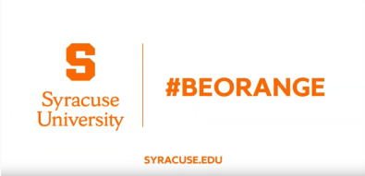
CTV/OTT & YouTube (:30 and :15 sec)
Title: What it Means to #BeOrange
Description: At Syracuse University, orange is more than just a color. Orange is bright, bold and unafraid to change the world. If that sounds like you, come check us out. You can be anything you want to in life. Deciding to #BeOrange is a great way to start.
Learn more at: https://www.syracuse.edu/about/
https://youtu.be/JainYaRaBjo
https://youtu.be/Sg3YOz3k4zE

Slide 17



YouTube Pre-Roll (:6 sec)
LINK: https://www.youtube.com/watch?v=PvH7jAOc_vc&feature=youtu.be
LINK: https://www.youtube.com/watch?v=FKNJgTtE0sI&feature=youtu.be
LINK: https://www.youtube.com/watch?v=M2M-u20F1YY&feature=youtu.be

Slide 18

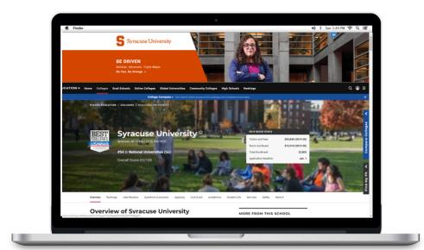
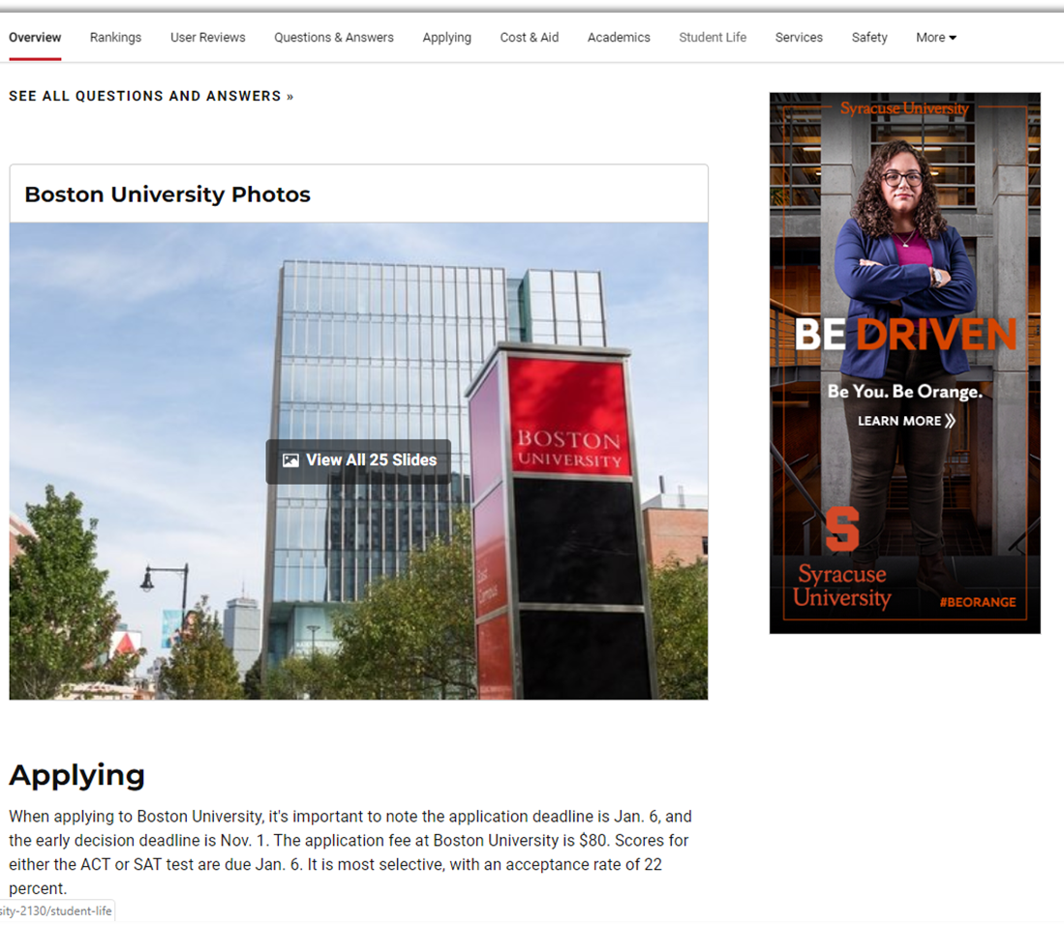
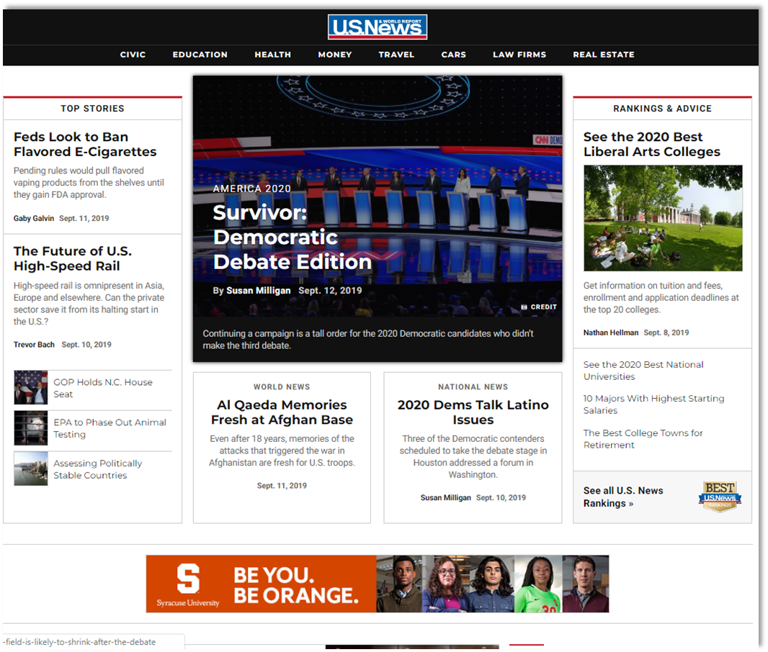
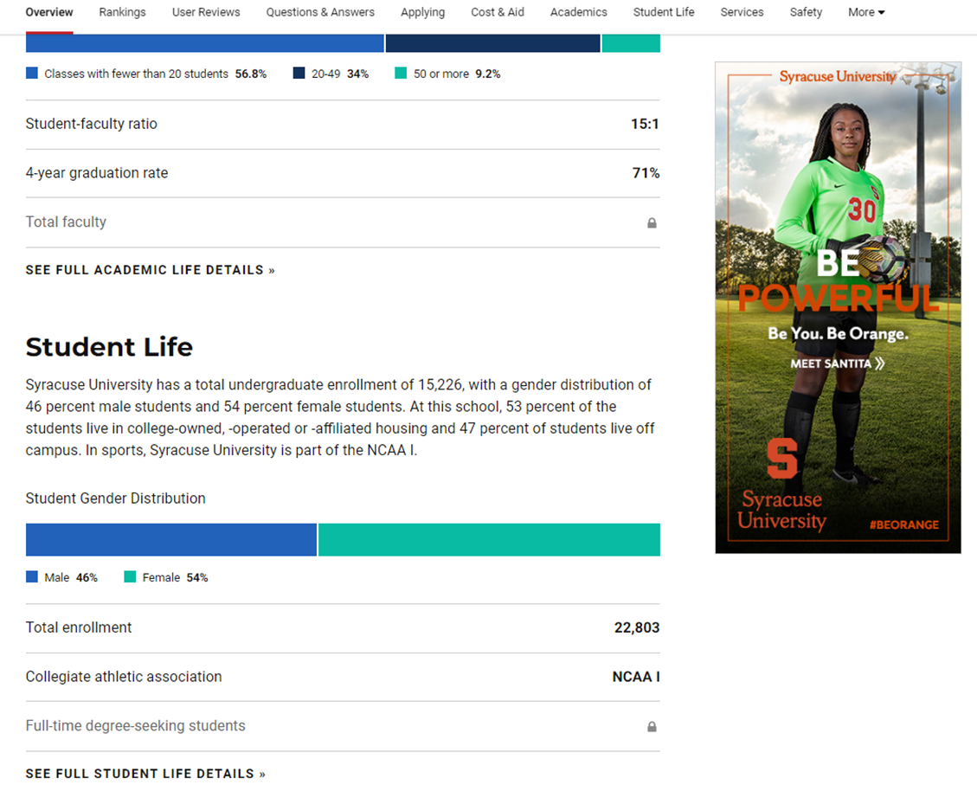
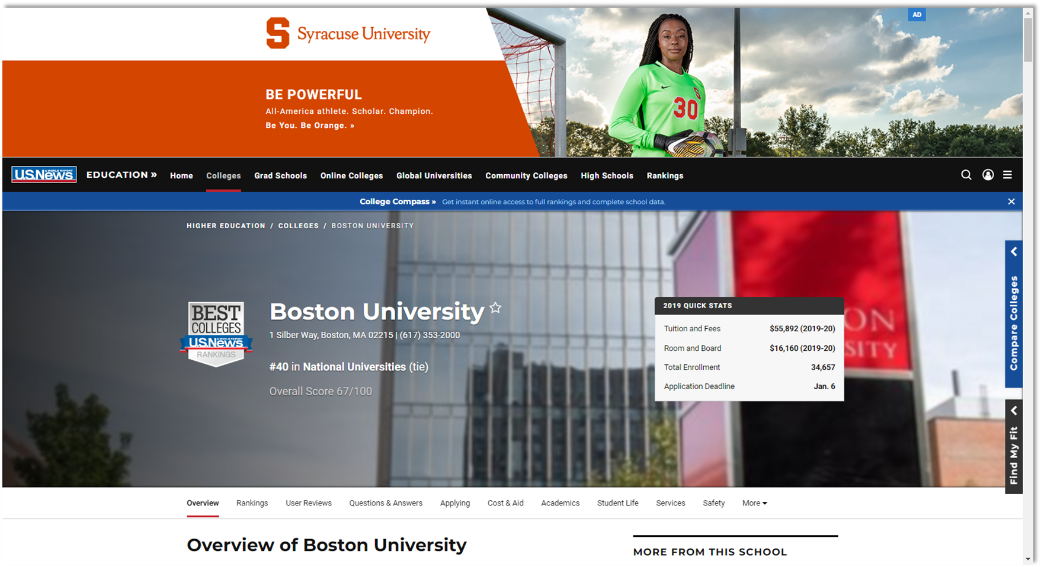
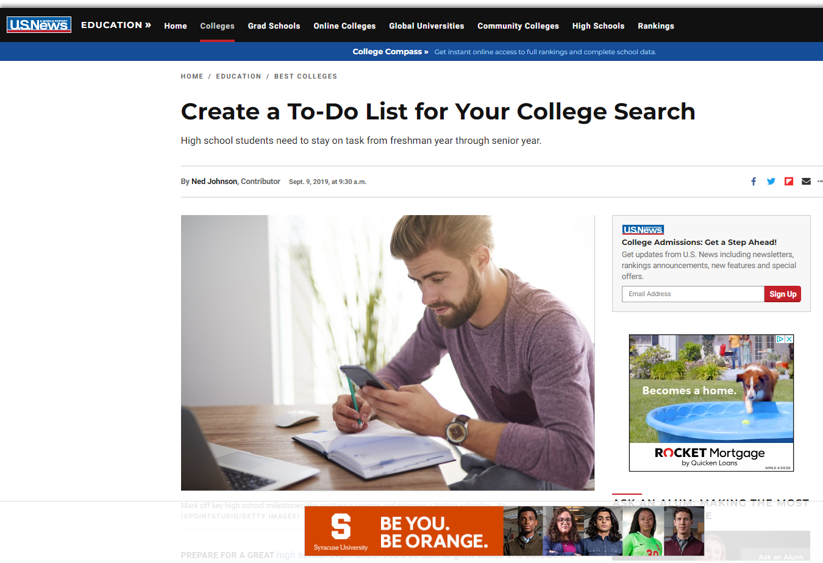

U.S. News and World Report Rankings Issue Digital

Slide 19
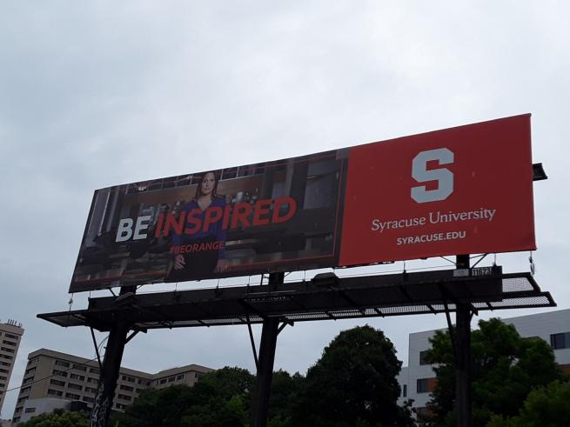

OOH Billboard

Slide 20
Campaign Summary Results
Truly integrated multi-channel campaign include: Syracuse.edu Website, CTV, Google Search, Instagram, Snapchat, Facebook, LinkedIn, YouTube Pre-Roll and Bumper Ads, Programmatic Display, Airport/OOH, Wall Street Journal, US News and World Report, Forbes, Fortune, Business Week, The Week, Entrepreneur, Delta Sky Mag and more.
Total of nearly 40 Million impressions have been delivered across all channels, highest ever for Syracuse University, for a 3-month campaign.
Digital campaign showed 22% higher impressions compared to prior phases and over 100% growth in clicks.
Digital placements have results in nearly 100K clicks to our website with a above benchmark CTR of 0.25%.
Almost all digital platforms performed on or above industry benchmarks. A/B testing provided actionable insights for future campaigns and made for on the spot optimizations.

Slide 21
Thank you!
Sid Bhattacharya
AVP, Marketing Strategy
sibhatta@syr.edu

